Slide 1

IQN: In-Band Quality Notification
Sergey Gorinsky
IMDEA Networks Institute, Spain
joint work with Leonardo Peroni and Farzad Tashtarian
Amazon Web Services, online presentation
12 June 2025

Slide 2
Motivation
Related Work
Solution
Implementation
Evaluation
2
Discussion
Motivation
Why do Internet service providers (ISPs) struggle
with quality of experience (QoE) management?
Sergey Gorinsky, “In-Band Quality Notification from Users to ISPs”, AWS online, 2025/6/12

Slide 3


Motivation
Related Work
Solution
Implementation
Evaluation
3
Discussion
Over-The-Top (OTT) Adaptive Video Streaming
OTT server
OTT client
video stream
data center
ISP
end-user device
end user
4
3
2
1
variable bandwidth
QoE
data volume
stall
4
3
2
1
4
3
2
1
4
3
2
1
4
3
2
1
video segments
(e.g., 4 seconds long)
⚠️ QoE improvement is a key objective
Sergey Gorinsky, “In-Band Quality Notification from Users to ISPs”, AWS online, 2025/6/12

Slide 4
Motivation
Related Work
Solution
Implementation
Evaluation
4
Discussion
ISPs Have the Means and Incentives to Improve QoE
impaired QoE
insufficient bandwidth
stall
video stream
ISP
end-user device
end user
🛠️ Means
➜ traffic prioritization
➜ rerouting
💰 Incentives
➜ connectivity market competitiveness
➜ customer attraction and retention
3
2
⚠️ But first, ISPs must detect QoE impairment
Sergey Gorinsky, “In-Band Quality Notification from Users to ISPs”, AWS online, 2025/6/12

Slide 5


Motivation
Related Work
Solution
Implementation
Evaluation
5
Discussion
Independent ISP-Side QoE Inference Is Challenging
QoE?
OTT server
OTT client
encrypted video stream
data center
ISP
end-user device
end user
ℹ️ OTT providers encrypt traffic end-to-end, e.g., with QUIC
❌ Encryption renders deep packet inspection (DPI) ineffective
❌ Independent learning-based QoE inference struggles with accuracy
🤔 Who might assist ISPs in QoE inference?
Sergey Gorinsky, “In-Band Quality Notification from Users to ISPs”, AWS online, 2025/6/12

Slide 6
Motivation
Related Work
Solution
Implementation
Evaluation
6
Discussion
Potential Assistants in ISP-Side QoE Inference
QoE?
OTT server
OTT client
encrypted video stream
data center
ISP
end-user device
end user
❌ OTT providers
➜ control QoE on their own and have little incentive to share insights with ISPs
✅ End users
➜ directly benefit from QoE improvement and have access to QoE information
⚠️ End users require a mechanism for notifying ISPs of QoE
Sergey Gorinsky, “In-Band Quality Notification from Users to ISPs”, AWS online, 2025/6/12

Slide 7
Motivation
Related Work
Solution
Implementation
Evaluation
7
Discussion
The End User Is Aware of the Access ISP Only
insufficient bandwidth
OTT client
encrypted video stream
bottleneck ISP
access ISP
end-user device
end user
bilateral relationship
ℹ️ Internet operates through bilateral agreements
➜ e.g., between an end user and access ISP
⚠️ The bandwidth bottleneck might be in other ISPs
⚠️ Need to notify ISPs beyond the access provider
Sergey Gorinsky, “In-Band Quality Notification from Users to ISPs”, AWS online, 2025/6/12

Slide 8
Motivation
Related Work
Solution
Implementation
Evaluation
8
Discussion
Network Address Translation (NAT) Alters Flows
insufficient bandwidth
OTT client
encrypted video stream
NAT
bottleneck ISP
access ISP
end-user device
end user
ℹ️ NAT modifies the identifiers of network flows
ℹ️ The same video stream has different flow identifiers
➜ flow X in the bottleneck ISP
➜ flow Y in the end-user device
⚠️ The notification mechanism must function despite NAT
Sergey Gorinsky, “In-Band Quality Notification from Users to ISPs”, AWS online, 2025/6/12

Slide 9
Motivation
Related Work
Solution
Implementation
Evaluation
9
Discussion
Asymmetric Routing Complicates Notifications
ℹ️ The bottleneck ISP might be off the client-to-server path
OTT server
data center
insufficient bandwidth
OTT client
encrypted video stream
end user
bottleneck ISP
access ISP
end-user device
⚠️ Notifications must reach ISPs along the server-to-client path
Sergey Gorinsky, “In-Band Quality Notification from Users to ISPs”, AWS online, 2025/6/12

Slide 10
Motivation
Related Work
Solution
Implementation
Evaluation
10
Discussion
Problem Statement
✻ Design a mechanism that:
➜ enables the end user of the OTT streaming service to signal QoE
➜ notifies ISPs beyond the access provider along the server-to-client path
✻ With no support from the OTT provider
✻ Despite end-to-end traffic encryption, NAT, and asymmetric routing
OTT server
OTT client
❌
❌
ISP
QoE
Sergey Gorinsky, “In-Band Quality Notification from Users to ISPs”, AWS online, 2025/6/12

Slide 11
Motivation
Related Work
Solution
Implementation
Evaluation
11
Discussion
Related Work
How do end users and remote ISPs communicate today?
Sergey Gorinsky, “In-Band Quality Notification from Users to ISPs”, AWS online, 2025/6/12

Slide 12
Motivation
Related Work
Solution
Implementation
Evaluation
12
Discussion
Application-Layer Traffic Optimization (ALTO)
queries
ALTO server
ALTO protocol
ALTO client
network information
ISP
end-user device
ℹ️ IETF RFC 7285
ℹ️ Exposes network topologies, routing preferences, and cost maps to applications
ℹ️ Enables the client in its selection of another endpoint, e.g., a server or a peer
❌ ALTO does not provide application information to ISPs
Sergey Gorinsky, “In-Band Quality Notification from Users to ISPs”, AWS online, 2025/6/12

Slide 13
Motivation
Related Work
Solution
Implementation
Evaluation
13
Discussion
CAMARA Quality on Demand (QoD)
request
upgrade
QoD API
QoD API
NAT
OTT server
OTT client
data center
bottleneck ISP
access ISP
end-user device
ℹ️ Application programming interface (API) of Linux Foundation’s CAMARA project
ℹ️ Out-of-band signaling from applications to ISPs, mostly mobile providers
ℹ️ Enables applications to request network quality upgrades
❌ CAMARA QoD struggles to identify remote ISPs and right flows
Sergey Gorinsky, “In-Band Quality Notification from Users to ISPs”, AWS online, 2025/6/12

Slide 14
Motivation
Related Work
Solution
Implementation
Evaluation
14
Discussion
Network Cookies
ℹ️ Stanford, ACM SIGCOMM 2016
ℹ️ User-inserted metadata in packets
ℹ️ Enable users to signal preferences
➜ to ISPs and OTT providers
OTT server
data center
insufficient bandwidth
OTT client
encrypted video stream
NAT
end user
bottleneck ISP
access ISP
end-user device
❌ Network cookies require OTT support to reach server-to-client ISPs
Sergey Gorinsky, “In-Band Quality Notification from Users to ISPs”, AWS online, 2025/6/12

Slide 15
Motivation
Related Work
Solution
Implementation
Evaluation
15
Discussion
Solution
How do we advance the state of the art?
Sergey Gorinsky, “In-Band Quality Notification from Users to ISPs”, AWS online, 2025/6/12

Slide 16
Motivation
Related Work
Solution
Implementation
Evaluation
16
Discussion
In-Band Quality Notification (IQN)
ℹ️ New general mechanism for QoE signaling from end users to ISPs
➜ adaptable to different OTT services and QoE signals
➜ building block for QoE management protocols
ℹ️ Two core (automated) components:
➜ user agent (sender)
➜ ISP agent (receiver)
OTT client
QoE
ISP agent
user agent
ISP
end-user device
Sergey Gorinsky, “In-Band Quality Notification from Users to ISPs”, AWS online, 2025/6/12

Slide 17

Motivation
Related Work
Solution
Implementation
Evaluation
17
Discussion
IQN Key Insights
💡To engage with the user, the OTT client exposes interactive features:
OTT client
💡 Which the user agent leverages to induce:
➜ a distinctive packet pattern in client-to-server traffic
OTT client
user agent
ℹ️ The OTT server reacts by generating:
➜ a distinctive packet pattern in server-to-client traffic
OTT server
ISP agent
QoE
💡 This enables the ISP agent to infer QoE:
➜ from the observed server-to-client packet pattern
Sergey Gorinsky, “In-Band Quality Notification from Users to ISPs”, AWS online, 2025/6/12

Slide 18
Motivation
Related Work
Solution
Implementation
Evaluation
18
Discussion
IQN: Putting It All Together
✅ compatible with NAT
✅ works despite encryption, asymmetric routing
✅ requires no support from the OTT provider
OTT server
data center
ISP agent
OTT client
QoE
NAT
user agent
bottleneck ISP
access ISP
end-user device
end user
✅ IQN successfully notifies server-to-client ISPs of QoE
Sergey Gorinsky, “In-Band Quality Notification from Users to ISPs”, AWS online, 2025/6/12

Slide 19
Motivation
Related Work
Solution
Implementation
Evaluation
19
Discussion
Implementation
Is IQN feasible?
Sergey Gorinsky, “In-Band Quality Notification from Users to ISPs”, AWS online, 2025/6/12

Slide 20

Motivation
Related Work
Solution
Implementation
Evaluation
20
Discussion
IQN Instantiation in YouStall
ℹ️ OTT service: YouTube
ℹ️ QoE signal: video stall
ℹ️ OTT client’s interactive feature: autoplay switch
ℹ️ Inducing a distinctive packet pattern:
➜ toggle autoplay even times (4 toggles) with short intervals (5 ms)
➜ periodically repeat while a stall persists
ℹ️ Inferring QoE from server-to-client packet timing: ● ● ● ● ● ● ● ● ● ● ● ● ● ● ●
➜ identify candidate packets (size: 1,180 – 1,288 bytes)
➜ apply two sliding windows over packet arrivals to detect stall start and end
Sergey Gorinsky, “In-Band Quality Notification from Users to ISPs”, AWS online, 2025/6/12

Slide 21

Motivation
Related Work
Solution
Implementation
Evaluation
21
Discussion
Stall Detection by YouStall’s User Agent
ℹ️ Recognition of YouTube’s spinning icon in periodic screenshots
no stall
stall
stall
stall
no stall
time
🔄 Alternative: YouTube’s Stats for Nerds
YouStall code available at https://github.com/Leo-rojo/IQN_YouStall_Code_CloudNet_2024
Sergey Gorinsky, “In-Band Quality Notification from Users to ISPs”, AWS online, 2025/6/12

Slide 22
Motivation
Related Work
Solution
Implementation
Evaluation
22
Discussion
Evaluation
Is IQN effective in our prototype?
Sergey Gorinsky, “In-Band Quality Notification from Users to ISPs”, AWS online, 2025/6/12

Slide 23

Motivation
Related Work
Solution
Implementation
Evaluation
23
Discussion
Experimental Topology
YouTube server
YouTube client
Internet
ISP agent
OpenVPN
data center
user agent
EC2, Frankfurt
ℹ️ End-user device
➜ runs YouStall’s user agent
ℹ️ Amazon Elastic Compute Cloud (EC2) instance
➜ emulates an ISP and hosts YouStall’s ISP agent
➜ tunnels user traffic over OpenVPN before sending it over the public Internet
end-user device, Madrid
Sergey Gorinsky, “In-Band Quality Notification from Users to ISPs”, AWS online, 2025/6/12

Slide 24

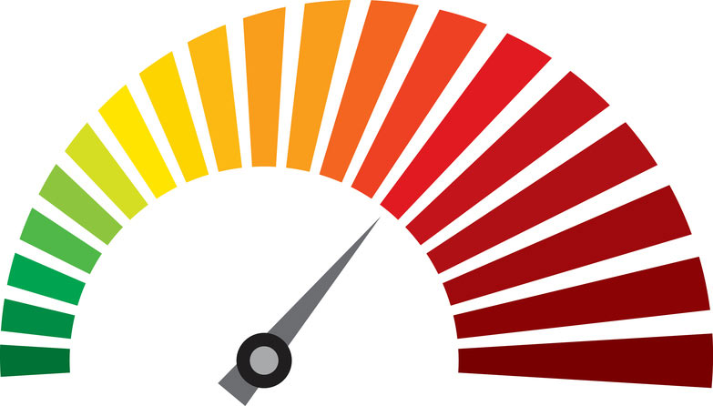


Motivation
Related Work
Solution
Implementation
Evaluation
24
Discussion
Experimental Settings
ℹ️ YouTube Live videos
➜ three genres: news, music, and sports
➜ played automatically in Google Chrome
ℹ️ Stalls
➜ 100 per genre
➜ traffic limited to 1 Mbps using tcconfig
➜ resolution fixed at 720p
➜ ground truth: tracking via the ytp-spinner tag in Selenium
➜ timelines synchronized with screenshot timelines
ℹ️ Memory and processing overhead
➜ measured using psutil
Sergey Gorinsky, “In-Band Quality Notification from Users to ISPs”, AWS online, 2025/6/12

Slide 25
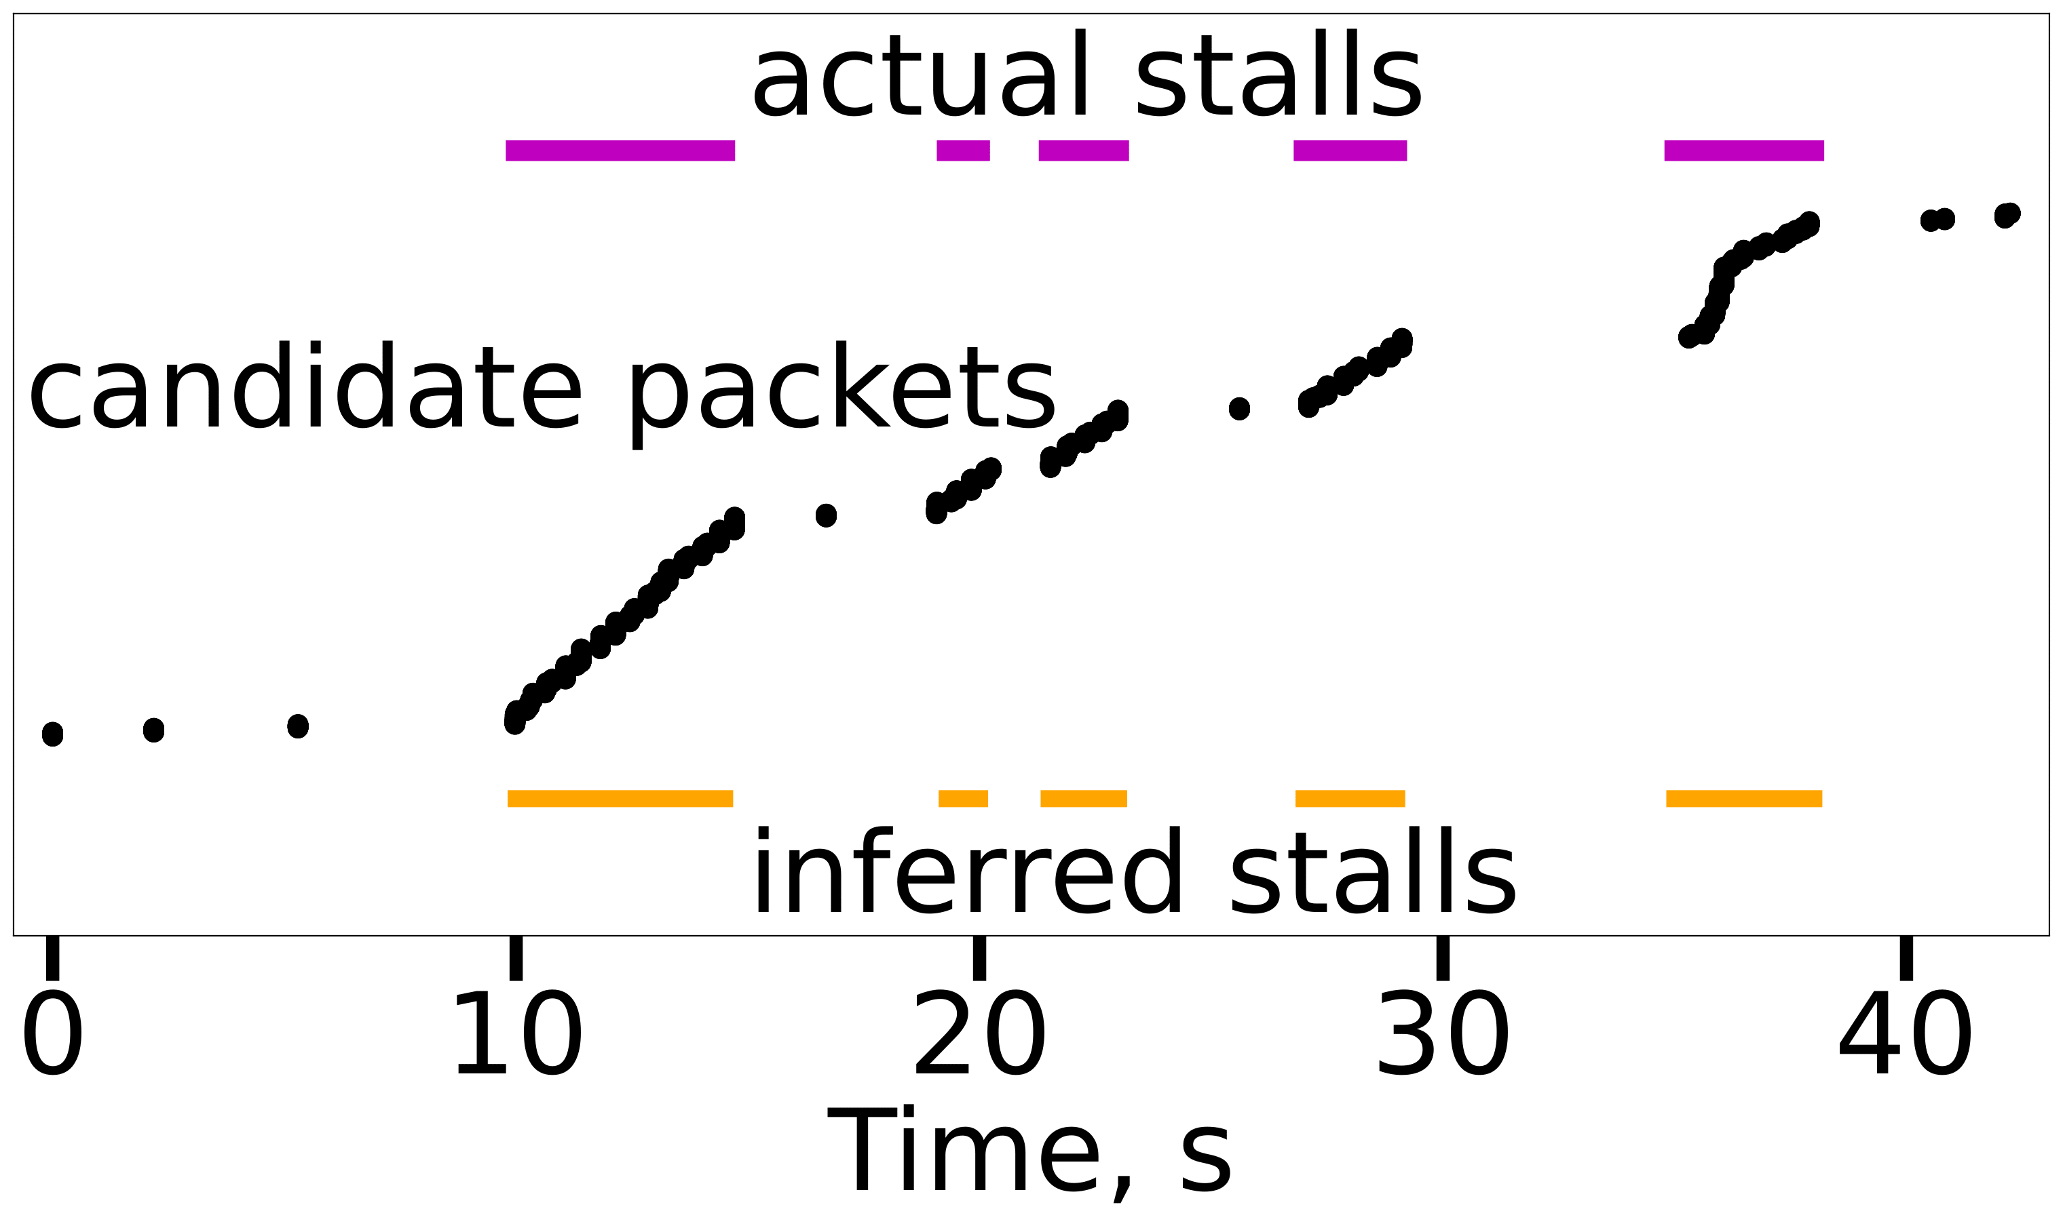
Motivation
Related Work
Solution
Implementation
Evaluation
25
Discussion
Operational Example
on the end-user device
candidate packet number
at the ISP
✅ IQN enables YouStall to accurately detect actual stalls at the ISP
Sergey Gorinsky, “In-Band Quality Notification from Users to ISPs”, AWS online, 2025/6/12

Slide 26
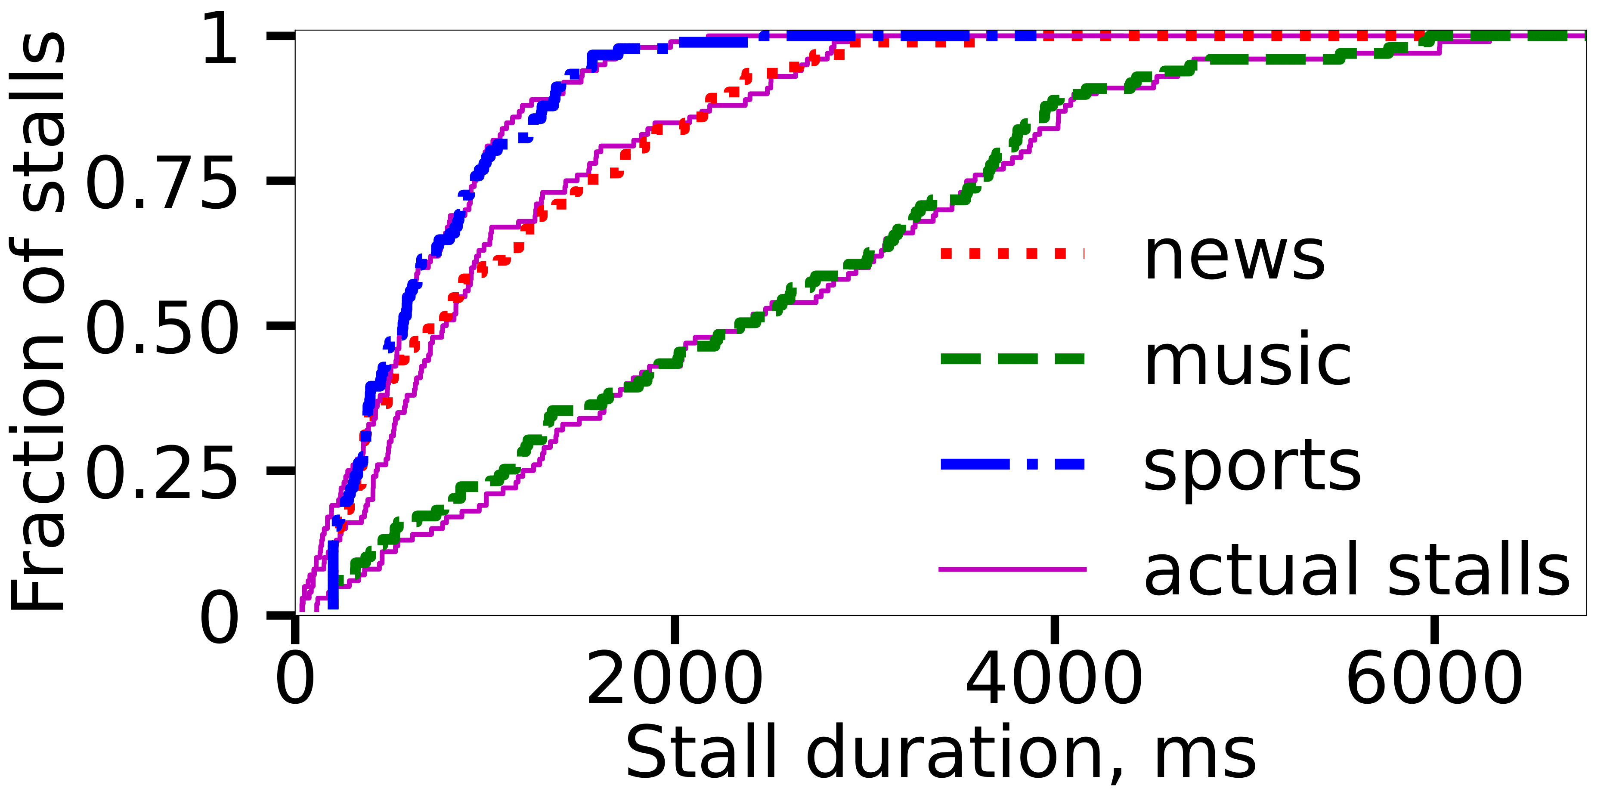
Motivation
Related Work
Solution
Implementation
Evaluation
26
Discussion
Duration of Inferred vs. Actual Stalls
✅ YouStall accurately infers stall-duration distributions
Sergey Gorinsky, “In-Band Quality Notification from Users to ISPs”, AWS online, 2025/6/12

Slide 27
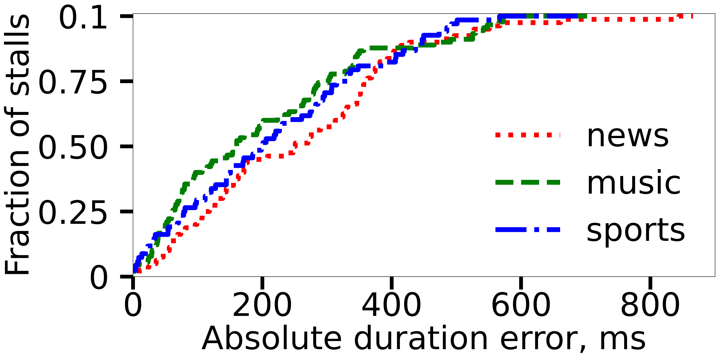
Motivation
Related Work
Solution
Implementation
Evaluation
27
Discussion
Duration Error for Significant Stalls
✻ stall duration
➜ average
● 1.4 s
➜ significant
● at least 400 ms
✻ average error
➜ 200-300 ms
✅ YouStall estimates the duration of significant stalls with low error
Sergey Gorinsky, “In-Band Quality Notification from Users to ISPs”, AWS online, 2025/6/12

Slide 28
Motivation
Related Work
Solution
Implementation
Evaluation
28
Discussion
Discussion
What are open questions and challenges?
Sergey Gorinsky, “In-Band Quality Notification from Users to ISPs”, AWS online, 2025/6/12

Slide 29
Motivation
Related Work
Solution
Implementation
Evaluation
29
Discussion
Integrating IQN into QoE Management Protocols
✻ Coordination between multiple server-to-client ISPs
❌ requires an additional explicit mechanism
✅ each ISP acts independently
✻ ISP action while receiving IQN signals
❌ enforces absolute per-domain performance levels (like CAMARA QoD)
✅ grants relatively higher priority to the video flow on each traversed link
OTT client
⏫
⏫
⏫
IQN
OTT server
IQN
IQN
IQN
ISPs
QoE
Sergey Gorinsky, “In-Band Quality Notification from Users to ISPs”, AWS online, 2025/6/12

Slide 30




Motivation
Related Work
Solution
Implementation
Evaluation
30
Discussion
Additional Considerations
✻ Deployment
✅ by an ISP, an ISP consortium, or a third party
✻ Dynamic maintenance
🔄 standard practice in modern software
✻ Deliberate disruption of IQN signaling by OTT providers
⚠️ may trigger neutrality regulations for OTT providers
✻ Scalability of OTT-specific IQN instantiation
✅ feasible due to the relatively small number of OTT hypergiants
✻ Privacy
🔒 IQN shares only QoE information, not video content
Sergey Gorinsky, “In-Band Quality Notification from Users to ISPs”, AWS online, 2025/6/12

Slide 31
Motivation
Related Work
Solution
Implementation
Evaluation
31
Discussion
IQN Relevance to ISPs
✻ Establishing a direct relationship with end users
✅ particularly beneficial for remote ISPs
✻ Enhancing QoE at a network-layer timescale
✅ reacts within hundreds of milliseconds
✅ faster than OTT providers' application-layer adjustments (seconds)
✻ Monetization opportunities
💰 subscription-based services
💰 advertisements in IQN’s user agents on end-user devices
Sergey Gorinsky, “In-Band Quality Notification from Users to ISPs”, AWS online, 2025/6/12

Slide 32
Motivation
Related Work
Solution
Implementation
Evaluation
32
Discussion
Future Work
📊 Further research on IQN
➜ stalls vs. other QoE metrics
➜ binary impairment signaling vs. QoE value encoding
🛠️ IQN integration into QoE management
➜ developing new mechanisms for QoE detection by user agents
➜ exploring techniques for QoE improvement by ISPs
➜ studying fairness considerations
🔗 Extending IQN to additional OTT services
🤝 Collaborating with ISPs for real-world IQN experimentation
Sergey Gorinsky, “In-Band Quality Notification from Users to ISPs”, AWS online, 2025/6/12

Slide 33





33
Acknowledgments
DRONAC (PID2022-140560OB-I00)
funded by
MICIU/AEI/10.13039/501100011033 and ERDF, EU
Christian Doppler Laboratory ATHENA
funded by
Sergey Gorinsky, “In-Band Quality Notification from Users to ISPs”, AWS online, 2025/6/12

Slide 34
34
Conclusions
✻ Problem
❌ ISPs struggle to infer QoE, limiting their ability to improve it
❌ existing solutions (e.g., ALTO and CAMARA QoD) do not fully bridge the gap
✻ In-band Quality Notification (IQN): a new mechanism
✅ enables end users to notify ISPs of QoE
✅ works despite encryption, asymmetric routing, and NAT
✅ requires no OTT support
✻ Next steps
🛠️ IQN integration into QoE management and real-world testing
🙌 Let us explore the possibilities together!
Sergey Gorinsky, “In-Band Quality Notification from Users to ISPs”, AWS online, 2025/6/12

