Slide 1

Enhanced QoE Through Personalization
and In-Band Quality Notification
Sergey Gorinsky
IMDEA Networks Institute, Spain
joint work with Leonardo Peroni, Farzad Tashtarian, and Christian Timmerer
Stellenbosch University, South Africa
7 April 2025

Slide 2


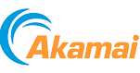

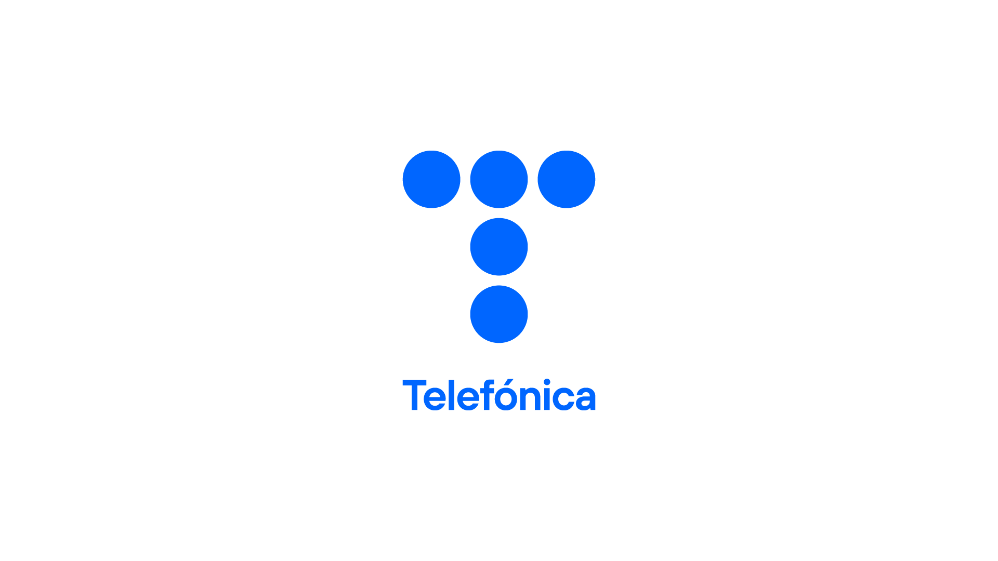










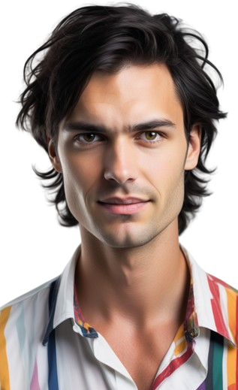
Introduction
iQoE
2
IQN
Video Streaming Ecosystem
content delivery networks (CDNs)
over-the-top (OTT)
streaming providers
Internet service providers (ISPs)
Internet
processing
ingestion
distribution
content providers (CPs)
end users
⚠️ The distribution stage must deliver content in real time
Sergey Gorinsky, “Enhanced QoE Through Personalization and In-Band Quality Notification”, Stellenbosch University

Slide 3

Introduction
iQoE
3
IQN
Adaptive Video Streaming by OTT Providers
OTT server
OTT client
video stream
data center
Internet
end-user device
end user
4
3
2
1
variable bandwidth
streaming experience
data volume
stall
4
3
2
1
4
3
2
1
4
3
2
1
4
3
2
1
video segments
(e.g., 4 seconds long)
⚠️ User satisfaction is a key performance objective
Sergey Gorinsky, “Enhanced QoE Through Personalization and In-Band Quality Notification”, Stellenbosch University

Slide 4
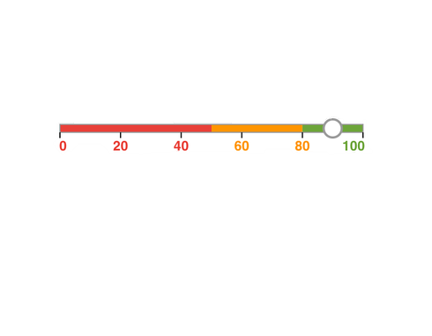
Introduction
iQoE
4
IQN
Quality of Experience (QoE)
stall
4
3
2
1
1
streaming experience
end user
user interface
ℹ️ Overall satisfaction with the streaming service as perceived by the user
ℹ️ Measured through subjective assessment
⚠️ Subjective assessments are time-consuming and burdensome
🤔 Can QoE be measured objectively?
Sergey Gorinsky, “Enhanced QoE Through Personalization and In-Band Quality Notification”, Stellenbosch University

Slide 5

Introduction
iQoE
5
IQN
Influence Factors (IFs) and QoE Models
ℹ️ Multitude of objective IFs
➜ stall duration
➜ image quality
➜ stability of image quality
➜ start-up latency
➜ …
ℹ️ QoE models
➜ defined as functions of IFs
➜ numerous proposals exist
≈
🤔 How are QoE models constructed?
Sergey Gorinsky, “Enhanced QoE Through Personalization and In-Band Quality Notification”, Stellenbosch University

Slide 6
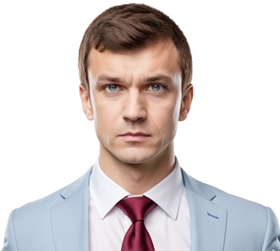



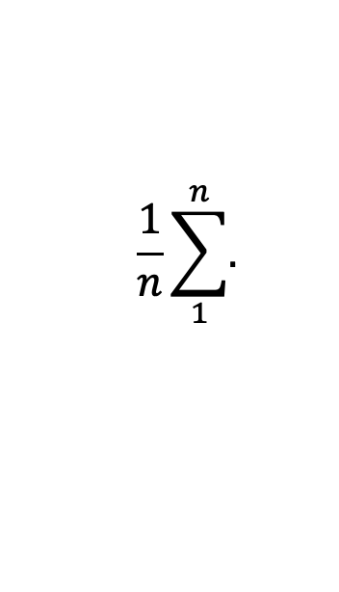
Introduction
iQoE
6
IQN
Traditional QoE Modeling
raters
stall
sampler
score
modeler
4
3
2
1
$$\frac{1}{n}\sum_{1}^{n}{.}$$
experience
score
MOS
…
…
…
experiences
score
MOSes
QoE model
experiences
…
influence factors
ℹ️ Mean opinion score (MOS) captures the QoE perception by the average rater
⚠️ The output is a one-size-fits-all QoE model
Sergey Gorinsky, “Enhanced QoE Through Personalization and In-Band Quality Notification”, Stellenbosch University

Slide 7

Introduction
iQoE
7
IQN
Usage of the QoE Model by ABR Streaming
QoE-based ABR streaming system
viewer
regular streaming
regular streaming
QoE model
viewer
score
sampler
modeler
$$\frac{1}{n}\sum_{1}^{n}{.}$$
MOS
experience
Score
…
…
…
experiences
score
MOSes
experiences
raters
…
model
influence factors
traditional QoE modeling
Sergey Gorinsky, “Enhanced QoE Through Personalization and In-Band Quality Notification”, Stellenbosch University

Slide 8
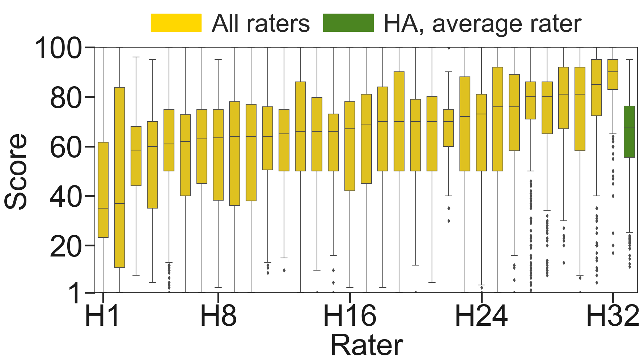
Introduction
iQoE
8
IQN
Diversity of QoE Perception
all raters
QoE model
ℹ️ Evaluation on the Waterloo-IV dataset
⚠️ The one-size-fits-all QoE model is inaccurate of for many users
Sergey Gorinsky, “Enhanced QoE Through Personalization and In-Band Quality Notification”, Stellenbosch University

Slide 9
Introduction
iQoE
9
IQN
© Magritte: This is not an Internet
⚠️ Technical solutions must align with economic realities
Sergey Gorinsky, “Enhanced QoE Through Personalization and In-Band Quality Notification”, Stellenbosch University

Slide 10
Introduction
iQoE
10
IQN
Thousands of ISPs Organized in Multiple Tiers
provider
provider
$
$
$
$
peer
peer
$
$
customer
customer
⚠️ Bilateral ISP agreements hinder offering end-to-end services
Sergey Gorinsky, “Enhanced QoE Through Personalization and In-Band Quality Notification”, Stellenbosch University

Slide 11
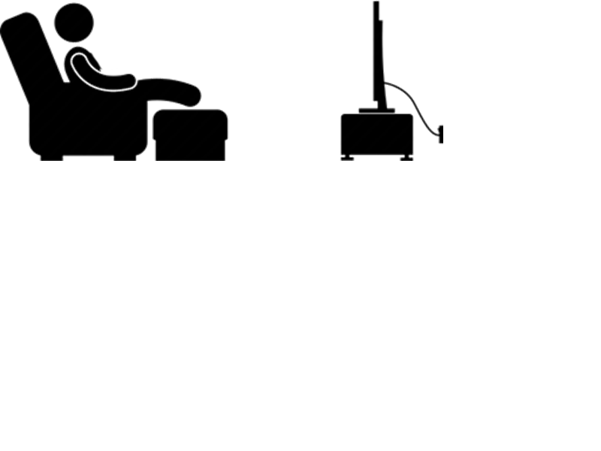

Introduction
iQoE
11
IQN
User Empowerment
passive role
active role
no effort, lower QoE
higher effort, higher QoE
💡 Providing the user with more opportunities to actively enhance QoE
ℹ️ Who provides these opportunities?
  ➜ OTT providers in individualised QoE (iQoE)
  ➜ ISPs in in-band quality notification (IQN)
⚠️ What are the challenges?
  ➜ Trade-off between user effort and QoE
  ➜ Deployabilty
Sergey Gorinsky, “Enhanced QoE Through Personalization and In-Band Quality Notification”, Stellenbosch University
Notes:
Active gives promis of higher QoE
Legacy user

Slide 12
Introduction
iQoE
12
IQN
iQoE: Low-Effort Personalized QoE Modeling
published in ACM CoNEXT 2023 and PACMNET
Sergey Gorinsky, “Enhanced QoE Through Personalization and In-Band Quality Notification”, Stellenbosch University

Slide 13
iQoE
Motivation
Design
Subjective Study
13
Simulations
Inaccuracy of a One-Size-Fits-All QoE Model
Atypical: 10% furthest from the median QoE perception
atypical raters
all raters
QoE model
(Waterloo-IV dataset)
⚠️ The inaccuracy is especially high for atypical viewers
Sergey Gorinsky, “Enhanced QoE Through Personalization and In-Band Quality Notification”, Stellenbosch University
Boxplot of 32 HDTV Users of Waterloo-IV dataset

Slide 14
iQoE
Motivation
Design
Subjective Study
14
Simulations
Our Approach
  💡 Personalization of QoE models
  ❌ Discarded alternatives
    ➜ indirect feedback
    ➜ multiple reference groups
    ➜ tuning of a generic QoE model
  💡 Required feedback
    ➜ explicit input from the viewer
    ➜ must be both expressible and actionable
  💡 The viewer is the sole rater for the personalized model
🤔 Can the personalization be done with low effort for the viewer?
Sergey Gorinsky, “Enhanced QoE Through Personalization and In-Band Quality Notification”, Stellenbosch University
Notes:
Explain x, inaccurate/not interpretable so we design feebacks, it should came from the same user that consume the content

Slide 15


iQoE
Motivation
Design
Subjective Study
15
Simulations
iQoE (individualised QoE)
💡 Limiting the subjective tests to a small number of experiences
💡 Active learning with new automatic sampler and modeler
  🛠️ Random Improved Greedy Sampling (RIGS)
  🛠️ eXtended Support Vector Regression (XSVR)
RIGS sampler
XSVR modeler
experience
score
…
viewer
…
…
experiences
scores
experiences
models and scores
influence factors
QoE
model
…
…
…
iQoE
Sergey Gorinsky, “Enhanced QoE Through Personalization and In-Band Quality Notification”, Stellenbosch University

Slide 16
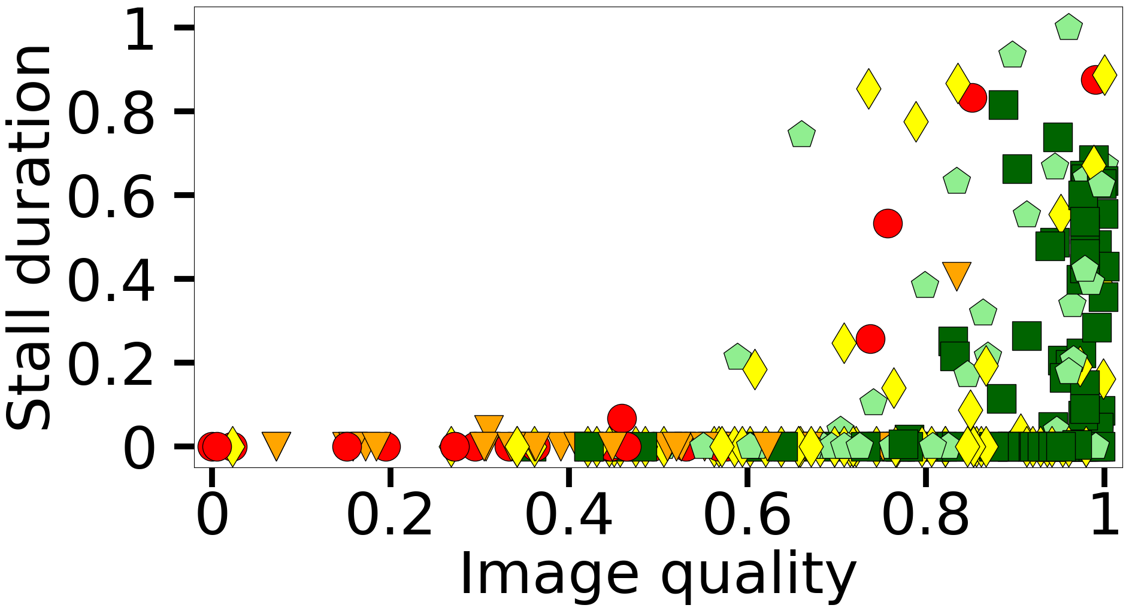
iQoE
Motivation
Design
Subjective Study
16
Simulations
How to Sample the Experience Set Representatively?
ℹ️ 315 experiences from the Waterloo-IV dataset
ℹ️ Input space: IF values for each experience
ℹ️ Output space: QoE scores assigned to the experiences
1-20 (bad) 21-40 (poor) 41-60 (fair) 61-80 (good) 81-100 (excellent)
better QoE
Sergey Gorinsky, “Enhanced QoE Through Personalization and In-Band Quality Notification”, Stellenbosch University

Slide 17
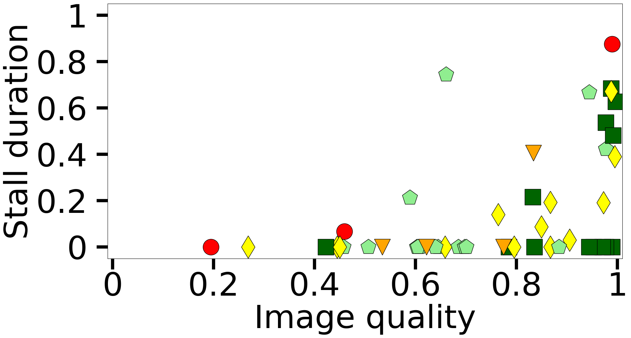
iQoE
Motivation
Design
Subjective Study
17
Simulations
Random Sampling (RS)
1-20 (bad) 21-40 (poor) 41-60 (fair) 61-80 (good) 81-100(excellent)
all 315 experiences
50 experiences chosen by RS
⚠️ Quick but with poor coverage of the input space
Sergey Gorinsky, “Enhanced QoE Through Personalization and In-Band Quality Notification”, Stellenbosch University

Slide 18
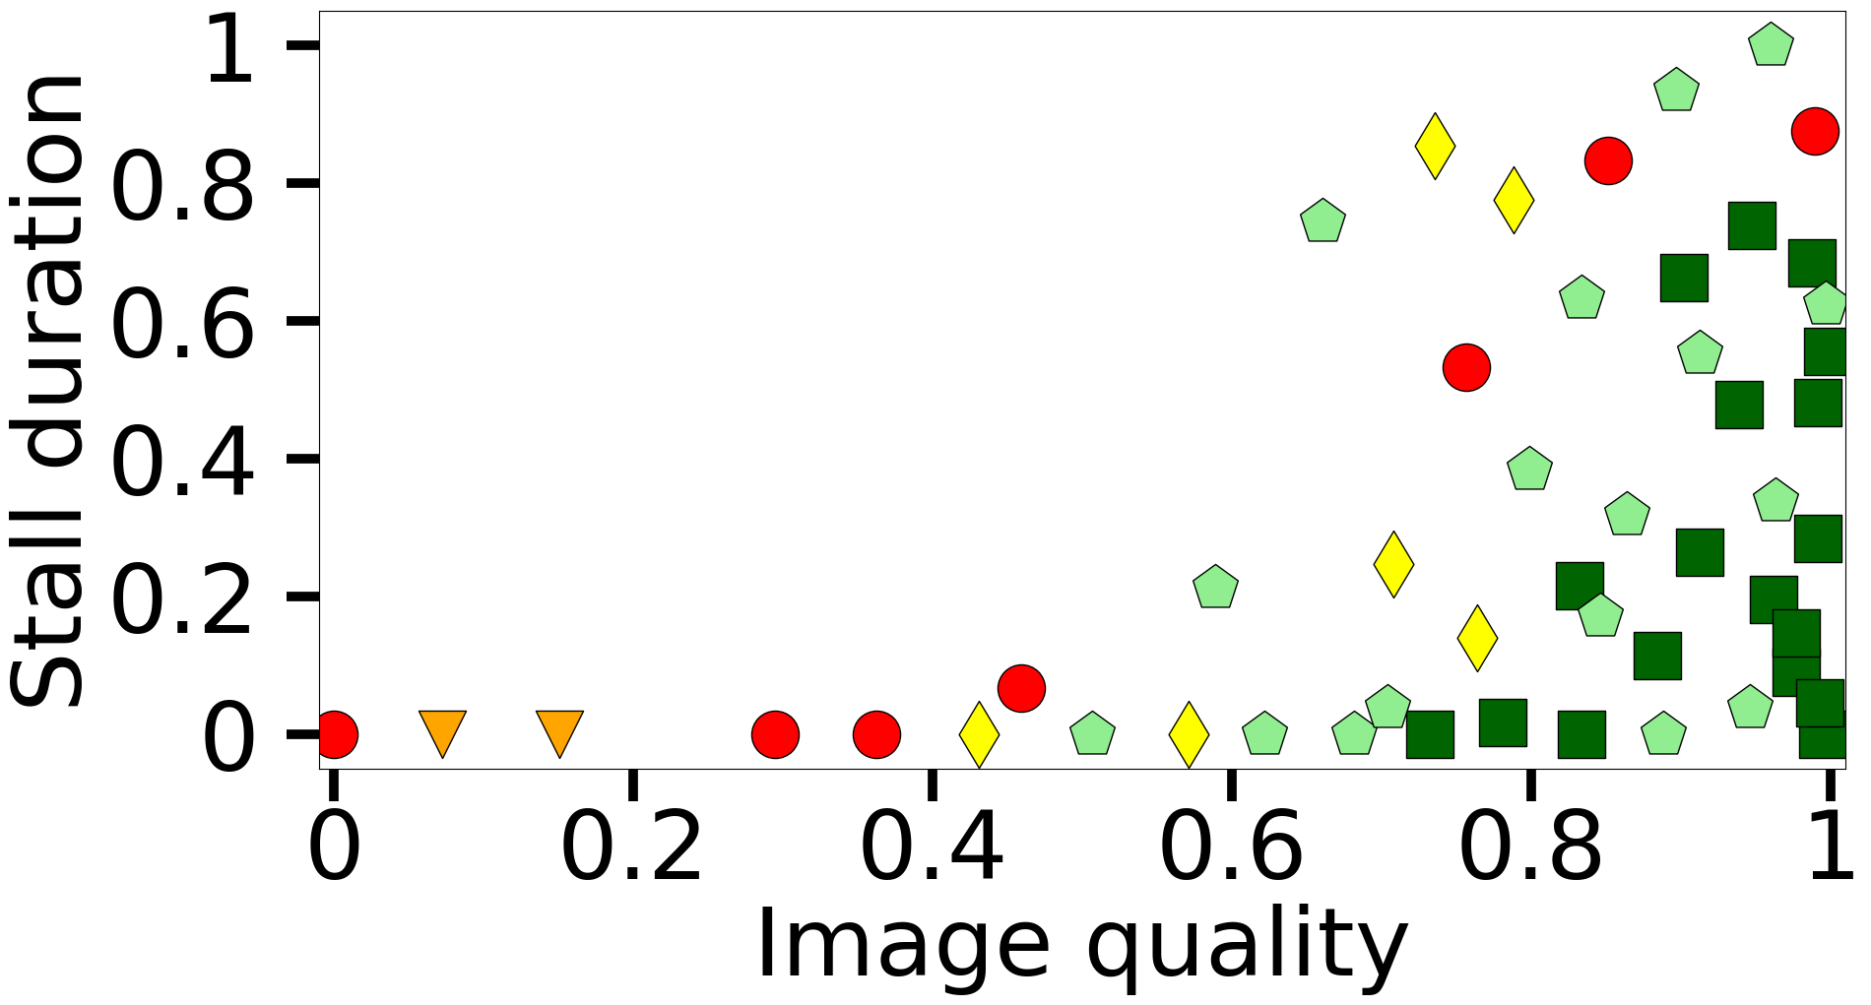
iQoE
Motivation
Design
Subjective Study
18
Simulations
Greedy Sampling (GS)
ℹ️ GS accounts for Euclidean distances in the space of IF values
1-20 (bad) 21-40 (poor) 41-60 (fair) 61-80 (good) 81-100(excellent)
50 experiences chosen by RS
50 experiences chosen by GS
⚠️ Poor coverage of the output space
Sergey Gorinsky, “Enhanced QoE Through Personalization and In-Band Quality Notification”, Stellenbosch University

Slide 19
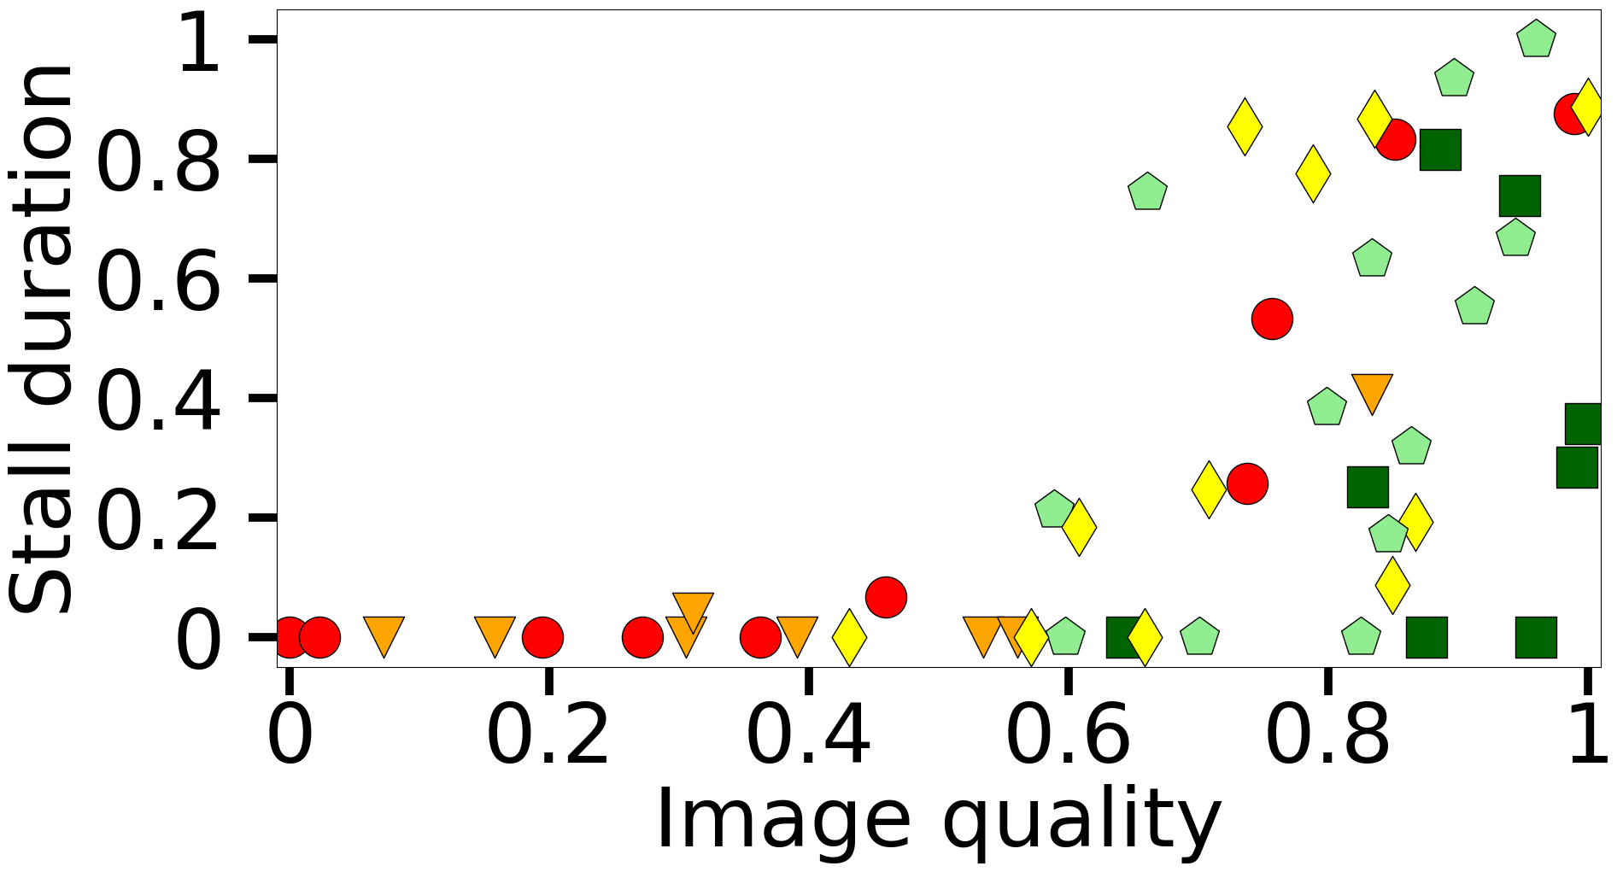
iQoE
Motivation
Design
Subjective Study
19
Simulations
Improved Greedy Sampling (IGS)
ℹ️ IGS accounts for Euclidean distances in both spaces of IF values and scores
1-20 (bad) 21-40 (poor) 41-60 (fair) 61-80 (good) 81-100(excellent)
50 experiences chosen by GS
50 experiences chosen by IGS
⚠️ Highest complexity with initially small gains
Sergey Gorinsky, “Enhanced QoE Through Personalization and In-Band Quality Notification”, Stellenbosch University

Slide 20
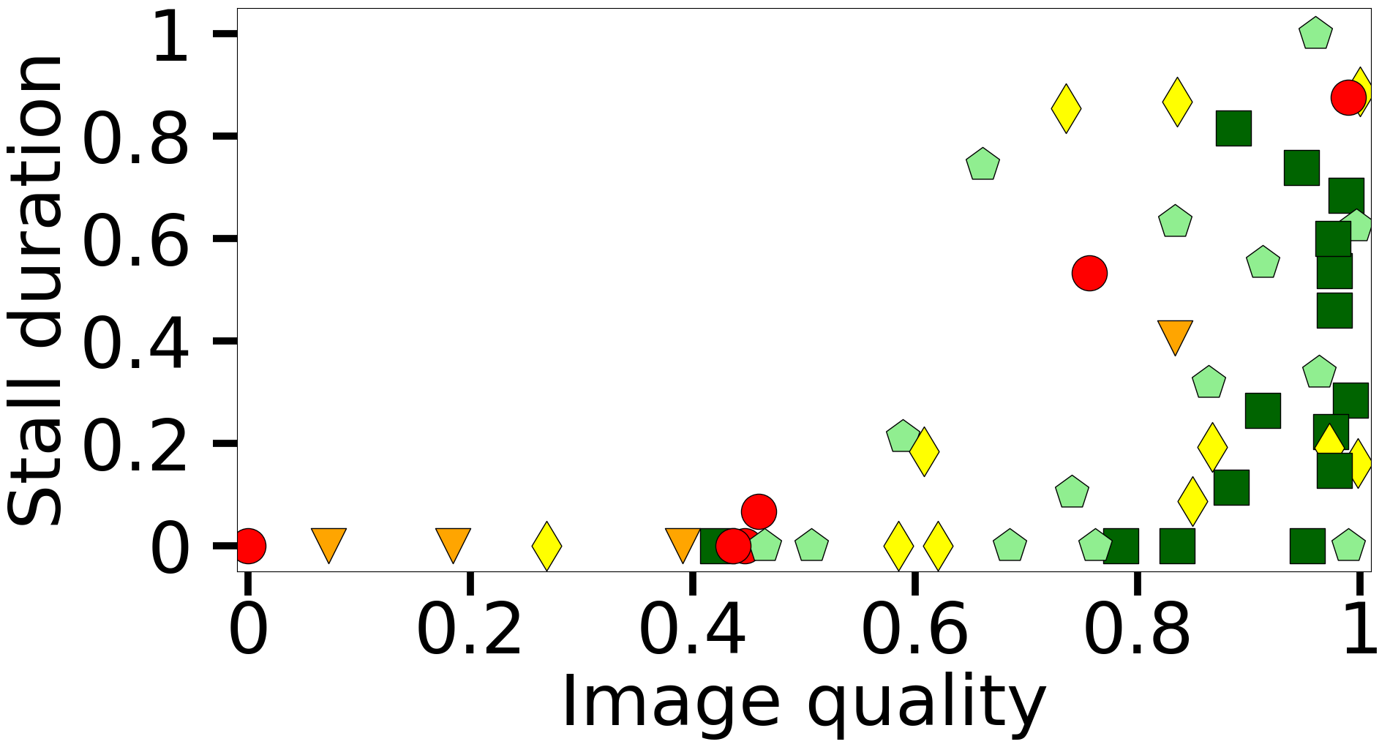
iQoE
Motivation
Design
Subjective Study
20
Simulations
Our RIGS Sampler
ℹ️ RS for the first h experiences and IGS for experiences h+1 to H
ℹ️ h = 10 and H = 50 experiences empirically
1-20 (bad) 21-40 (poor) 41-60 (fair) 61-80 (good) 81-100(excellent)
50 experiences chosen by RIGS
Sergey Gorinsky, “Enhanced QoE Through Personalization and In-Band Quality Notification”, Stellenbosch University

Slide 21
iQoE
Motivation
Design
Subjective Study
21
Simulations
Our XSVR Modeler
ℹ️ Support vector regression (SVR)
ℹ️ Set of 10 influence factors as features
  ➜ representation identifier
  ➜ stall duration
  ➜ bitrate
  ➜ chunk size
  ➜ frame width
  ➜ frame height
  ➜ highest bitrate flag
  ➜ peak signal-to-noise ratio (PSNR)
  ➜ structural similarity index measure (SSIM)
  ➜ video multi-method assessment fusion (VMAF)
ℹ️ Waterloo-IV dataset
✅ all are important
according to
permutation
feature importance

Slide 22

iQoE
Motivation
Design
Subjective Study
22
Simulations
iQoE’s Role in ABR Streaming
QoE-based ABR streaming system
regular streaming
viewer
QoE models
regular streaming
viewer
RIGS sampler
XSVR modeler
experience
score
…
…
viewer
…
experiences
scores
experiences
Influence factors
models and scores
…
QoE
model
…
…
iQoE
Sergey Gorinsky, “Enhanced QoE Through Personalization and In-Band Quality Notification”, Stellenbosch University

Slide 23
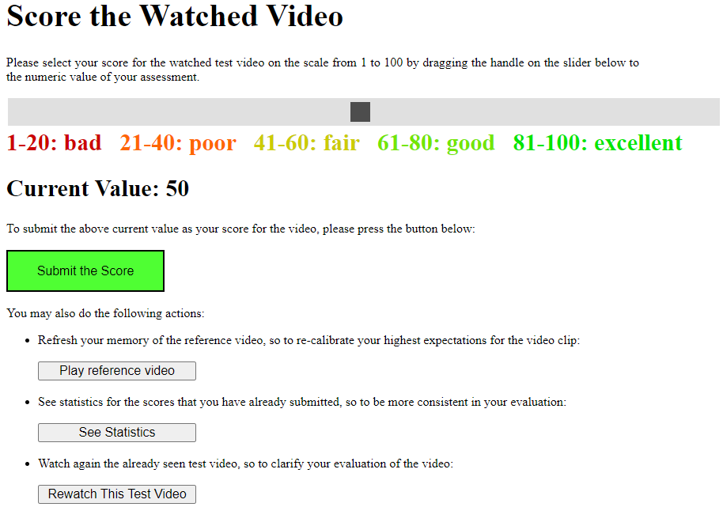
iQoE
Motivation
Design
Subjective Study
23
Simulations
Online Subjective Study with Real Viewers
🖥 Browser interface
ℹ️ 120 viewers in total, including 34 direct recruits and the rest from Microworkers
ℹ️ Each viewer rates 120 experiences for training and testing
ℹ️ Each experience consists of four segments
➜ 2-second playback per segment
➜ potential stalls between segments

Slide 24
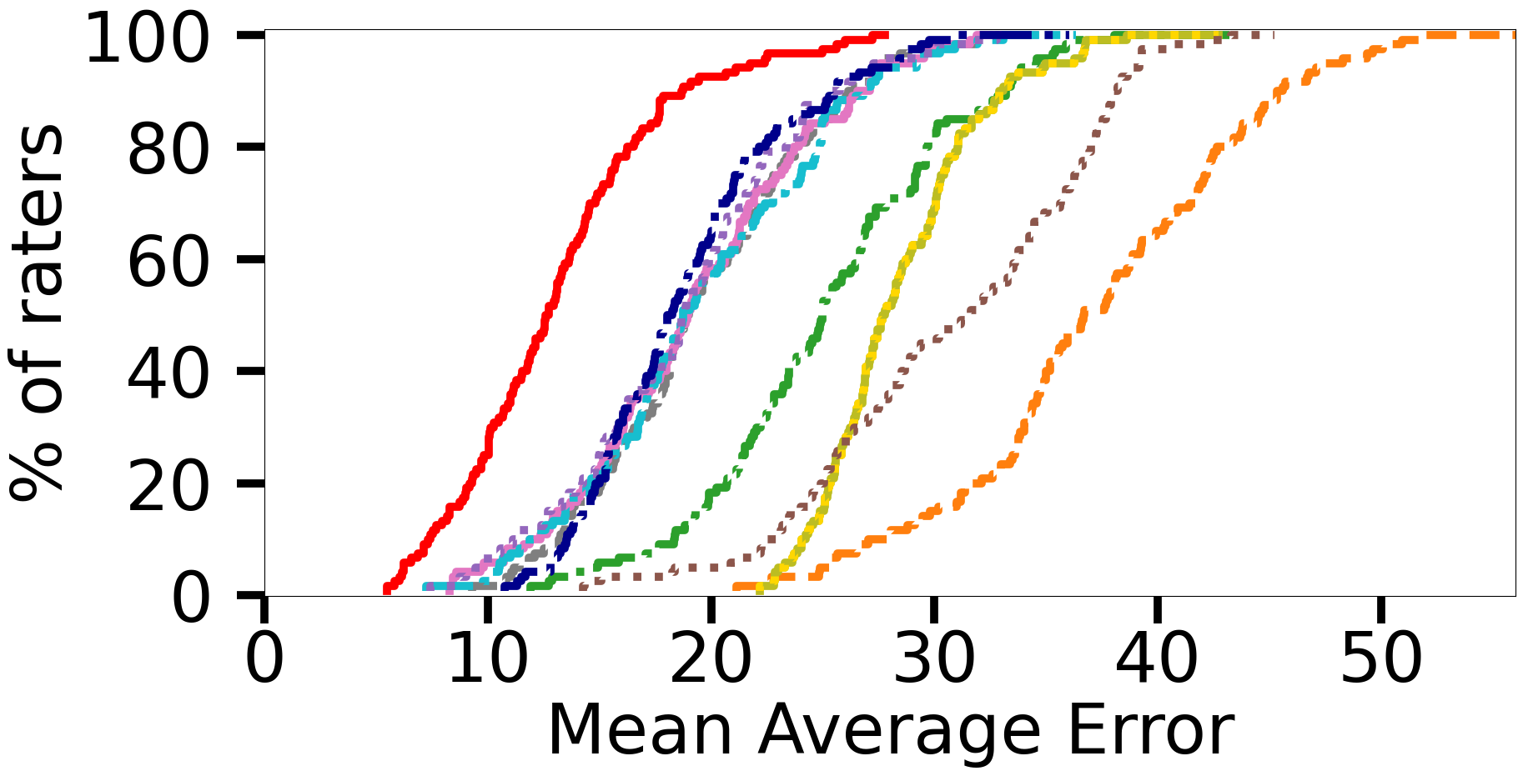
iQoE
Motivation
Design
Subjective Study
24
Simulations
Accuracy of iQoE vs. Traditional QoE Modeling
Prominent existing QoE models
Better
✅ Average MAE decreases at least 42% and 85%
for all raters and atypical raters, respectively
Sergey Gorinsky, “Enhanced QoE Through Personalization and In-Band Quality Notification”, Stellenbosch University

Slide 25



iQoE
Motivation
Design
Subjective Study
25
Simulations
Viewer’s Effort
✻ Playback time 7 minutes
✻ Extra time
✻ Expected effort of the viewer 22 minutes
✅ The viewer exerts reasonably low effort
Sergey Gorinsky, “Enhanced QoE Through Personalization and In-Band Quality Notification”, Stellenbosch University

Slide 26












iQoE
Motivation
Design
Subjective Study
26
Simulations
Simulations
8 QoE models scores of 32 real raters 256 synthetic raters
ℹ️ Extending real-world experiments to systematically evaluate:
  ➜ design choices
  ➜ parameter sensitivity
  ➜ overhead
ℹ️ Introducing a novel synthetic profiling technique:
  ➜ 256 synthetic raters, each assessing 1,000 experiences
Sergey Gorinsky, “Enhanced QoE Through Personalization and In-Band Quality Notification”, Stellenbosch University

Slide 27
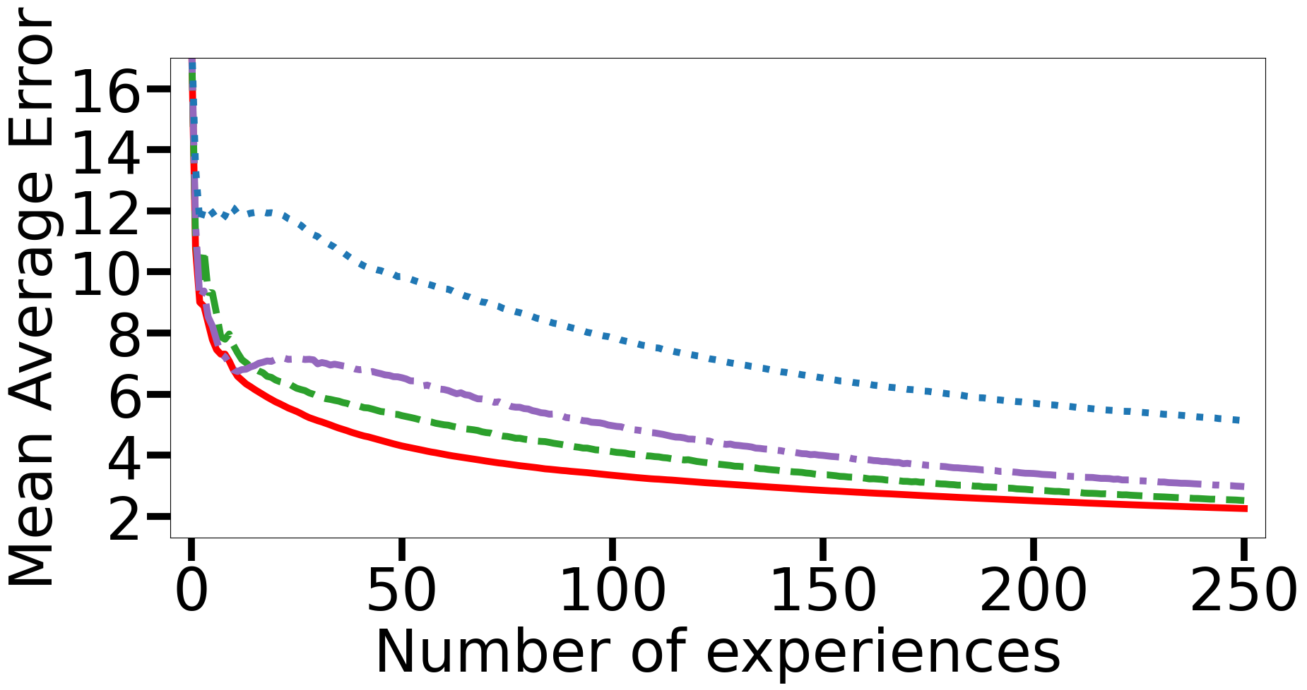
iQoE
Motivation
Design
Subjective Study
27
Simulations
Sensitivity to the Modeler Choice
iQoE RIGS + Extreme Gradient Boosting
RIGS + Random Forest RIGS + Gaussian Process
Better
✅ iQoE consistently outperforms design alternatives
Sergey Gorinsky, “Enhanced QoE Through Personalization and In-Band Quality Notification”, Stellenbosch University

Slide 28

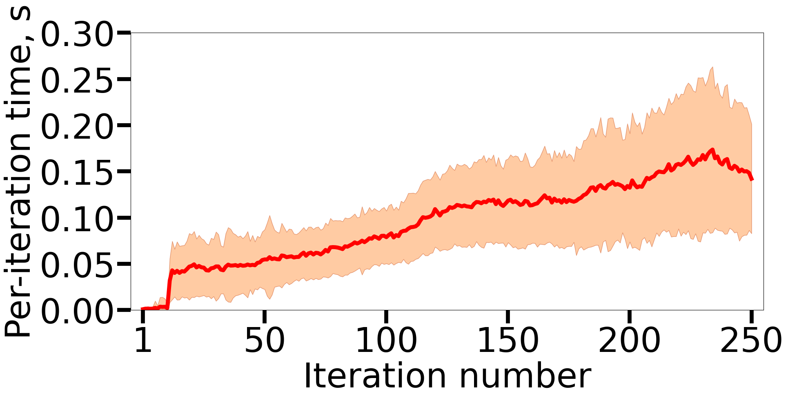
iQoE
Motivation
Design
Subjective Study
28
Simulations
iQoE Per-Iteration Time
Average Standard deviation
Switch from RS to IGS
✅ Processing and memory overhead of iQoE is negligible
Sergey Gorinsky, “Enhanced QoE Through Personalization and In-Band Quality Notification”, Stellenbosch University

Slide 29






Introduction
iQoE
29
IQN
Acknowledgments
SocialProbing (TED2021-131264B-I00)
funded by
Christian Doppler Laboratory ATHENA
funded by
GreenEdge (PID2021-128223OA-I00)
funded by
Sergey Gorinsky, “Enhanced QoE Through Personalization and In-Band Quality Notification”, Stellenbosch University

Slide 30



Introduction
iQoE
30
IQN
Conclusions
✻ iQoE: A new method for personalizing QoE models
💡Active learning, RIGS sampler, XSVR modeler
✻ Evaluation
🛠️ Online subjective study with 120 real viewers
🛠️ Simulations
✻ Results
  ✅ Accuracy improvement: 85% (42%) on average for atypical (all) viewers
  ✅ Viewer effort: 50 assessments, total training time: 22 minutes
Dataset and code available at: https://github.com/Leo-rojo/iQoE_Dataset_and_Code
ACM badges, among three papers selected for the Artifacts Session, CoNEXT 2023
Sergey Gorinsky, “Enhanced QoE Through Personalization and In-Band Quality Notification”, Stellenbosch University
Notes:
Mention code

Slide 31
Introduction
iQoE
31
IQN
IQN: In-Band Quality Notification from Users to ISPs
published in IEEE CloudNet 2024
Sergey Gorinsky, “Enhanced QoE Through Personalization and In-Band Quality Notification”, Stellenbosch University

Slide 32
IQN
Motivation
Related Work
Solution
Implementation
Evaluation
32
Discussion
Motivation
Why do Internet service providers (ISPs) struggle
with quality of experience (QoE) management?
Sergey Gorinsky, “Enhanced QoE Through Personalization and In-Band Quality Notification”, Stellenbosch University

Slide 33
IQN
Motivation
Related Work
Solution
Implementation
Evaluation
33
Discussion
ISPs Have the Means and Incentives to Improve QoE
impaired QoE
insufficient bandwidth
stall
video stream
ISP
end-user device
end user
🛠️ Means
➜ traffic prioritization
➜ rerouting
💰 Incentives
➜ connectivity market competitiveness
➜ customer attraction and retention
3
2
⚠️ But first, ISPs must detect QoE impairment
Sergey Gorinsky, “Enhanced QoE Through Personalization and In-Band Quality Notification”, Stellenbosch University

Slide 34


IQN
Motivation
Related Work
Solution
Implementation
Evaluation
34
Discussion
Independent ISP-Side QoE Inference Is Challenging
QoE?
OTT server
OTT client
encrypted video stream
data center
ISP
end-user device
end user
ℹ️ OTT providers encrypt traffic end-to-end, e.g., with QUIC
❌ Encryption renders deep packet inspection (DPI) ineffective
❌ Independent learning-based QoE inference struggles with accuracy
🤔 Who might assist ISPs in QoE inference?
Sergey Gorinsky, “Enhanced QoE Through Personalization and In-Band Quality Notification”, Stellenbosch University

Slide 35
IQN
Motivation
Related Work
Solution
Implementation
Evaluation
35
Discussion
Potential Assistants in ISP-Side QoE Inference
QoE?
OTT server
OTT client
encrypted video stream
data center
ISP
end-user device
end user
❌ OTT providers
➜ control QoE on their own and have little incentive to share insights with ISPs
✅ End users
➜ directly benefit from QoE improvement and have access to QoE information
⚠️ End users require a mechanism for notifying ISPs of QoE
Sergey Gorinsky, “Enhanced QoE Through Personalization and In-Band Quality Notification”, Stellenbosch University

Slide 36
IQN
Motivation
Related Work
Solution
Implementation
Evaluation
36
Discussion
The End User Is Aware of the Access ISP Only
insufficient bandwidth
OTT client
encrypted video stream
bottleneck ISP
access ISP
end-user device
end user
bilateral relationship
ℹ️ Internet operates through bilateral agreements
➜ e.g., between an end user and access ISP
⚠️ The bandwidth bottleneck might be in other ISPs
⚠️ Need to notify ISPs beyond the access provider
Sergey Gorinsky, “Enhanced QoE Through Personalization and In-Band Quality Notification”, Stellenbosch University

Slide 37
IQN
Motivation
Related Work
Solution
Implementation
Evaluation
37
Discussion
Asymmetric Routing Complicates Notifications
ℹ️ The bottleneck ISP might be off the client-to-server path
OTT server
data center
insufficient bandwidth
OTT client
encrypted video stream
end user
bottleneck ISP
access ISP
end-user device
⚠️ Notifications must reach ISPs along the server-to-client path
Sergey Gorinsky, “Enhanced QoE Through Personalization and In-Band Quality Notification”, Stellenbosch University

Slide 38
IQN
Motivation
Related Work
Solution
Implementation
Evaluation
38
Discussion
Network Address Translation (NAT) Alters Flows
insufficient bandwidth
OTT client
encrypted video stream
NAT
bottleneck ISP
access ISP
end-user device
end user
ℹ️ NAT modifies the identifiers of network flows
ℹ️ The same video stream has different flow identifiers
➜ flow X in the bottleneck ISP
➜ flow Y in the end-user device
⚠️ The notification mechanism must function despite NAT
Sergey Gorinsky, “Enhanced QoE Through Personalization and In-Band Quality Notification”, Stellenbosch University

Slide 39
IQN
Motivation
Related Work
Solution
Implementation
Evaluation
39
Discussion
Problem Statement
✻ Design a mechanism that:
➜ enables the end user of the OTT streaming service to signal QoE
➜ notifies ISPs beyond the access provider along the server-to-client path
✻ With no support from the OTT provider
✻ Despite end-to-end traffic encryption, asymmetric routing, and NAT
OTT server
OTT client
❌
❌
ISP
QoE
Sergey Gorinsky, “Enhanced QoE Through Personalization and In-Band Quality Notification”, Stellenbosch University

Slide 40
IQN
Motivation
Related Work
Solution
Implementation
Evaluation
40
Discussion
Related Work
How do end users and remote ISPs communicate today?
Sergey Gorinsky, “Enhanced QoE Through Personalization and In-Band Quality Notification”, Stellenbosch University

Slide 41
IQN
Motivation
Related Work
Solution
Implementation
Evaluation
41
Discussion
Application-Layer Traffic Optimization (ALTO)
queries
ALTO server
ALTO protocol
ALTO client
network information
ISP
end-user device
ℹ️ IETF RFC 7285
ℹ️ Exposes network topologies, routing preferences, and cost maps to applications
ℹ️ Enables the client in its selection of another endpoint, e.g., a server or a peer
❌ ALTO does not provide application information to ISPs
Sergey Gorinsky, “Enhanced QoE Through Personalization and In-Band Quality Notification”, Stellenbosch University

Slide 42
IQN
Motivation
Related Work
Solution
Implementation
Evaluation
42
Discussion
CAMARA Quality on Demand (QoD)
request
upgrade
QoD API
QoD API
NAT
OTT server
OTT client
data center
bottleneck ISP
access ISP
end-user device
ℹ️ Application programming interface (API) of Linux Foundation’s CAMARA project
ℹ️ Out-of-band signaling from applications to ISPs, mostly mobile providers
ℹ️ Enables applications to request network quality upgrades
❌ CAMARA QoD struggles to identify remote ISPs and right flows
Sergey Gorinsky, “Enhanced QoE Through Personalization and In-Band Quality Notification”, Stellenbosch University

Slide 43
IQN
Motivation
Related Work
Solution
Implementation
Evaluation
43
Discussion
Network Cookies
ℹ️ Stanford, ACM SIGCOMM 2016
ℹ️ User-inserted metadata in packets
ℹ️ Enable users to signal preferences
➜ to ISPs and OTT providers
OTT server
data center
insufficient bandwidth
OTT client
encrypted video stream
NAT
end user
bottleneck ISP
access ISP
end-user device
❌ Network cookies require OTT support to reach server-to-client ISPs
Sergey Gorinsky, “Enhanced QoE Through Personalization and In-Band Quality Notification”, Stellenbosch University

Slide 44
IQN
Motivation
Related Work
Solution
Implementation
Evaluation
44
Discussion
Solution
How do we advance the state of the art?
Sergey Gorinsky, “Enhanced QoE Through Personalization and In-Band Quality Notification”, Stellenbosch University

Slide 45
IQN
Motivation
Related Work
Solution
Implementation
Evaluation
45
Discussion
IQN (In-band Quality Notification)
ℹ️ New general mechanism for QoE signaling from end users to ISPs
➜ adaptable to different OTT services and QoE signals
➜ building block for QoE management protocols
ℹ️ Two core (automated) components:
➜ user agent (sender)
➜ ISP agent (receiver)
OTT client
QoE
ISP agent
user agent
ISP
end-user device
Sergey Gorinsky, “Enhanced QoE Through Personalization and In-Band Quality Notification”, Stellenbosch University

Slide 46

IQN
Motivation
Related Work
Solution
Implementation
Evaluation
46
Discussion
Key Insights
💡To engage with the user, the OTT client exposes interactive features:
OTT client
💡 Which the user agent leverages to induce:
➜ a distinctive packet pattern in client-to-server traffic
OTT client
user agent
ℹ️ The OTT server reacts by generating:
➜ a distinctive packet pattern in server-to-client traffic
OTT server
ISP agent
QoE
💡 This enables the ISP agent to infer QoE:
➜ from the observed server-to-client packet pattern
Sergey Gorinsky, “Enhanced QoE Through Personalization and In-Band Quality Notification”, Stellenbosch University

Slide 47
IQN
Motivation
Related Work
Solution
Implementation
Evaluation
47
Discussion
Putting It All Together
✅ compatible with NAT
✅ requires no support from the OTT provider
✅ works despite encryption, asymmetric routing
OTT server
data center
ISP agent
OTT client
QoE
NAT
user agent
bottleneck ISP
access ISP
end-user device
end user
✅ IQN successfully notifies server-to-client ISPs of QoE
Sergey Gorinsky, “Enhanced QoE Through Personalization and In-Band Quality Notification”, Stellenbosch University

Slide 48
IQN
Motivation
Related Work
Solution
Implementation
Evaluation
48
Discussion
Implementation
Is IQN feasible?
Sergey Gorinsky, “Enhanced QoE Through Personalization and In-Band Quality Notification”, Stellenbosch University

Slide 49

IQN
Motivation
Related Work
Solution
Implementation
Evaluation
49
Discussion
IQN Instantiation in YouStall
ℹ️ OTT service: YouTube
ℹ️ QoE signal: video stall
ℹ️ OTT client’s interactive feature: autoplay switch
ℹ️ Inducing a distinctive packet pattern:
➜ toggle autoplay even times (4 toggles) with short intervals (5 ms)
➜ periodically repeat while a stall persists
ℹ️ Inferring QoE from server-to-client packet timing: ● ● ● ● ● ● ● ● ● ● ● ● ● ● ●
➜ identify candidate packets (size: 1,180 – 1,288 bytes)
➜ apply two sliding windows over packet arrivals to detect stall start and end
Sergey Gorinsky, “Enhanced QoE Through Personalization and In-Band Quality Notification”, Stellenbosch University

Slide 50

IQN
Motivation
Related Work
Solution
Implementation
Evaluation
50
Discussion
Stall Detection by YouStall’s User Agent
ℹ️ Recognition of YouTube’s spinning icon in periodic screenshots
no stall
stall
stall
stall
no stall
time
🔄 Alternative: YouTube’s Stats for Nerds
YouStall code available at https://github.com/Leo-rojo/IQN_YouStall_Code_CloudNet_2024
Sergey Gorinsky, “Enhanced QoE Through Personalization and In-Band Quality Notification”, Stellenbosch University

Slide 51
IQN
Motivation
Related Work
Solution
Implementation
Evaluation
51
Discussion
Evaluation
Is IQN effective in our prototype?
Sergey Gorinsky, “Enhanced QoE Through Personalization and In-Band Quality Notification”, Stellenbosch University

Slide 52

IQN
Motivation
Related Work
Solution
Implementation
Evaluation
52
Discussion
Experimental Topology
YouTube server
YouTube client
Internet
ISP agent
OpenVPN
data center
user agent
EC2, Frankfurt
ℹ️ End-user device
➜ runs YouStall’s user agent
ℹ️ Amazon Elastic Compute Cloud (EC2) instance
➜ emulates an ISP and hosts YouStall’s ISP agent
➜ tunnels user traffic over OpenVPN before sending it over the public Internet
end-user device, Madrid
Sergey Gorinsky, “Enhanced QoE Through Personalization and In-Band Quality Notification”, Stellenbosch University

Slide 53

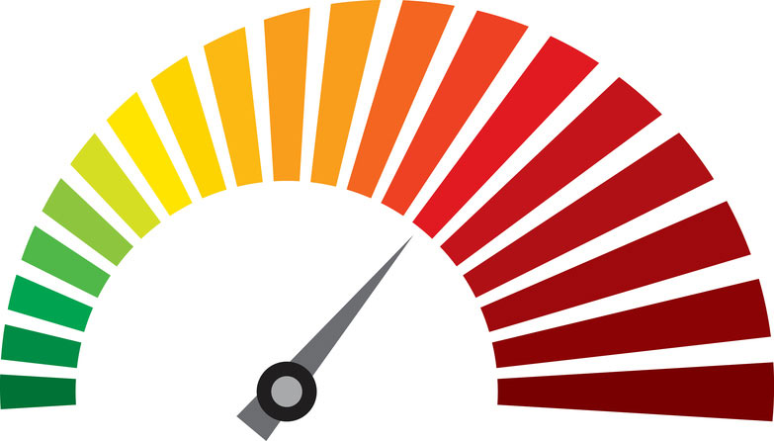


IQN
Motivation
Related Work
Solution
Implementation
Evaluation
53
Discussion
Experimental Settings
ℹ️ YouTube Live videos
➜ three genres: news, music, and sports
➜ played automatically in Google Chrome
ℹ️ Stalls
➜ 100 per genre
➜ traffic limited to 1 Mbps using tcconfig
➜ resolution fixed at 720p
➜ ground truth: tracking via the ytp-spinner tag in Selenium
➜ timelines synchronized with screenshot timelines
ℹ️ Memory and processing overhead
➜ measured using psutil
Sergey Gorinsky, “Enhanced QoE Through Personalization and In-Band Quality Notification”, Stellenbosch University

Slide 54
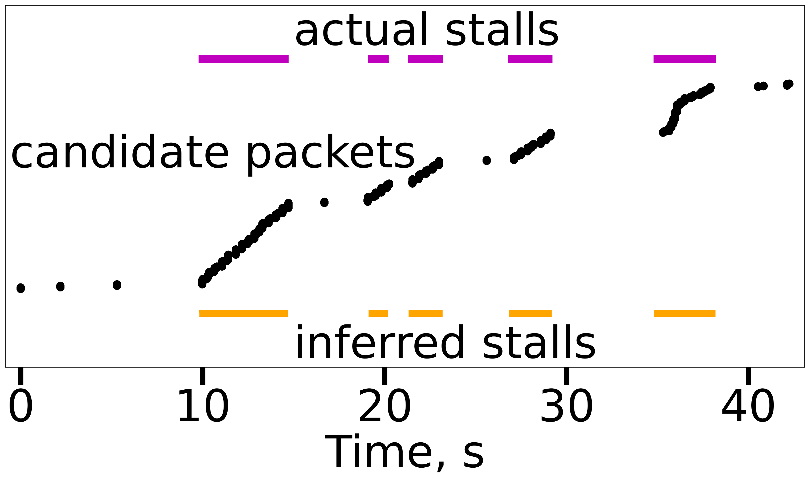
IQN
Motivation
Related Work
Solution
Implementation
Evaluation
54
Discussion
Operational Example
on the end-user device
candidate packet number
at the ISP
✅ IQN enables YouStall to accurately detect actual stalls at the ISP
Sergey Gorinsky, “Enhanced QoE Through Personalization and In-Band Quality Notification”, Stellenbosch University

Slide 55
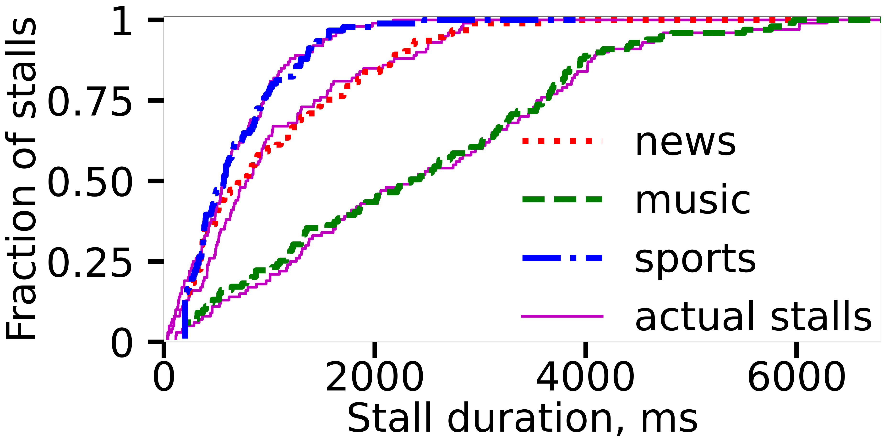
IQN
Motivation
Related Work
Solution
Implementation
Evaluation
55
Discussion
Duration of Inferred vs. Actual Stalls
✅ YouStall accurately infers stall-duration distributions
Sergey Gorinsky, “Enhanced QoE Through Personalization and In-Band Quality Notification”, Stellenbosch University

Slide 56
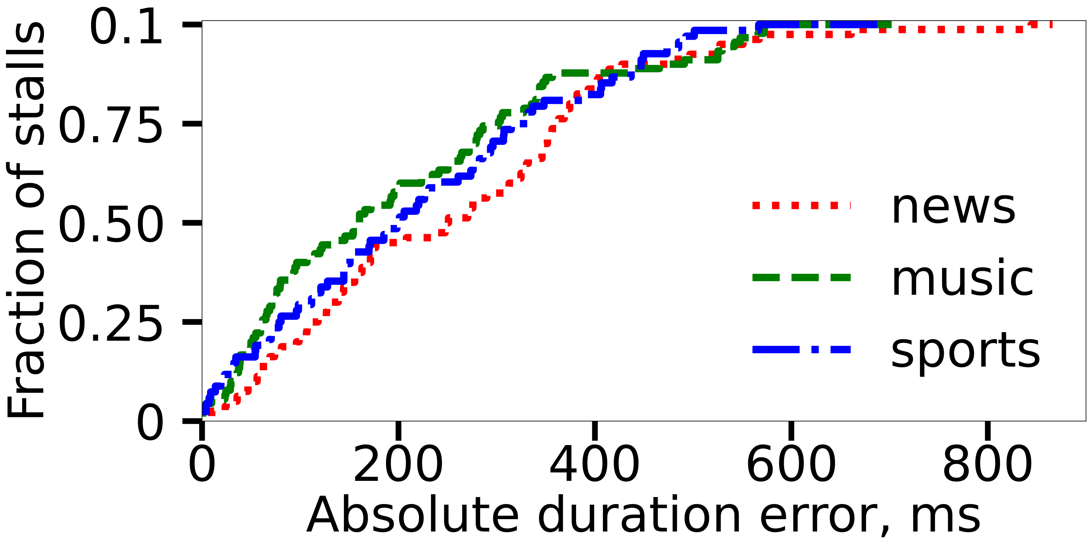
IQN
Motivation
Related Work
Solution
Implementation
Evaluation
56
Discussion
Duration Error for Significant Stalls
✻ Stall duration
➜ average
● 1.4 s
➜ significant
● at least 400 ms
✻ Average error
➜ 200-300 ms
✅ YouStall estimates the duration of significant stalls with low error
Sergey Gorinsky, “Enhanced QoE Through Personalization and In-Band Quality Notification”, Stellenbosch University

Slide 57
IQN
Motivation
Related Work
Solution
Implementation
Evaluation
57
Discussion
Discussion
What are open questions and challenges?
Sergey Gorinsky, “Enhanced QoE Through Personalization and In-Band Quality Notification”, Stellenbosch University

Slide 58
IQN
Motivation
Related Work
Solution
Implementation
Evaluation
58
Discussion
Integrating IQN into QoE Management Protocols
✻ Coordination between multiple server-to-client ISPs
❌ requires an additional explicit mechanism
✅ each ISP acts independently
✻ ISP action while receiving IQN signals
❌ enforces absolute per-domain performance levels (like CAMARA QoD)
✅ grants relatively higher priority to the video flow on each traversed link
OTT client
⏫
⏫
⏫
IQN
OTT server
IQN
IQN
IQN
ISPs
QoE
Sergey Gorinsky, “Enhanced QoE Through Personalization and In-Band Quality Notification”, Stellenbosch University

Slide 59
IQN
Motivation
Related Work
Solution
Implementation
Evaluation
59
Discussion
Additional Considerations
✻ Deployment
✅ by an ISP, an ISP consortium, or a third party
✻ Dynamic maintenance
🔄 standard practice in modern software
✻ Deliberate disruption of IQN signaling by OTT providers
⚠️ may trigger neutrality regulations for OTT providers
✻ Scalability of OTT-specific IQN instantiation
✅ feasible due to the relatively small number of OTT hypergiants
✻ Privacy
🔒 IQN shares only QoE information, not video content
Sergey Gorinsky, “Enhanced QoE Through Personalization and In-Band Quality Notification”, Stellenbosch University

Slide 60
IQN
Motivation
Related Work
Solution
Implementation
Evaluation
60
Discussion
IQN Relevance to ISPs
✻ Establishing a direct relationship with end users
✅ particularly beneficial for remote ISPs
✻ Enhancing QoE at a network-layer timescale
✅ reacts within hundreds of milliseconds
✅ faster than OTT providers' application-layer adjustments (seconds)
✻ Monetization opportunities
💰 subscription-based services
💰 advertisements in IQN’s user agents on end-user devices
Sergey Gorinsky, “Enhanced QoE Through Personalization and In-Band Quality Notification”, Stellenbosch University

Slide 61
IQN
Motivation
Related Work
Solution
Implementation
Evaluation
61
Discussion
Future Work
📊 Further research on IQN
➜ stalls vs. other QoE metrics
➜ binary impairment signaling vs. QoE value encoding
🛠️ IQN integration into QoE management
➜ developing new mechanisms for QoE detection by user agents
➜ exploring techniques for QoE improvement by ISPs
➜ studying fairness considerations
🔗 Extending IQN to additional OTT services
🤝 Collaborating with ISPs for real-world IQN experimentation
📜 Advancing IQN standardization efforts
Sergey Gorinsky, “Enhanced QoE Through Personalization and In-Band Quality Notification”, Stellenbosch University

Slide 62

Introduction
iQoE
62
IQN
Acknowledgments
DRONAC (PID2022-140560OB-I00)
funded by
MICIU/AEI/10.13039/501100011033 and ERDF, EU
Christian Doppler Laboratory ATHENA
funded by
Sergey Gorinsky, “Enhanced QoE Through Personalization and In-Band Quality Notification”, Stellenbosch University

Slide 63
Introduction
iQoE
63
IQN
Conclusions
✻ Problem
❌ ISPs struggle to infer QoE, limiting their ability to improve it
❌ existing solutions (e.g., ALTO and CAMARA QoD) do not fully bridge the gap
✻ In-band Quality Notification (IQN): a new mechanism
✅ enables end users to notify ISPs of QoE
✅ works despite encryption, asymmetric routing, and NAT
✅ requires no OTT support
✻ Next steps
🛠️ IQN integration into QoE management
🛠️ real-world testing
🛠️ standardization
Sergey Gorinsky, “Enhanced QoE Through Personalization and In-Band Quality Notification”, Stellenbosch University

Slide 64
Introduction
iQoE
64
IQN
Overall Summary
✻ Video streaming: a diverse and evolving ecosystem
➜ involves multiple diverse stakeholders: ISPs, OTT providers, end users
➜ shaped by new technical mechanisms and business models
✻ iQoE: Low-effort personalization of QoE model
✅ builds an accurate QoE model for individual users
✅ uses active learning to efficiently adapt to user preferences
✻ IQN: In-band QoE signaling
✅ enables QoE signaling from end users to ISPs
✅ leverages the OTT client’s interface
✅ requires no support from OTT providers
Sergey Gorinsky, “Enhanced QoE Through Personalization and In-Band Quality Notification”, Stellenbosch University

Slide 65
Backup Slides
Sergey Gorinsky, “Enhanced QoE Through Personalization and In-Band Quality Notification”, Stellenbosch University

Slide 66
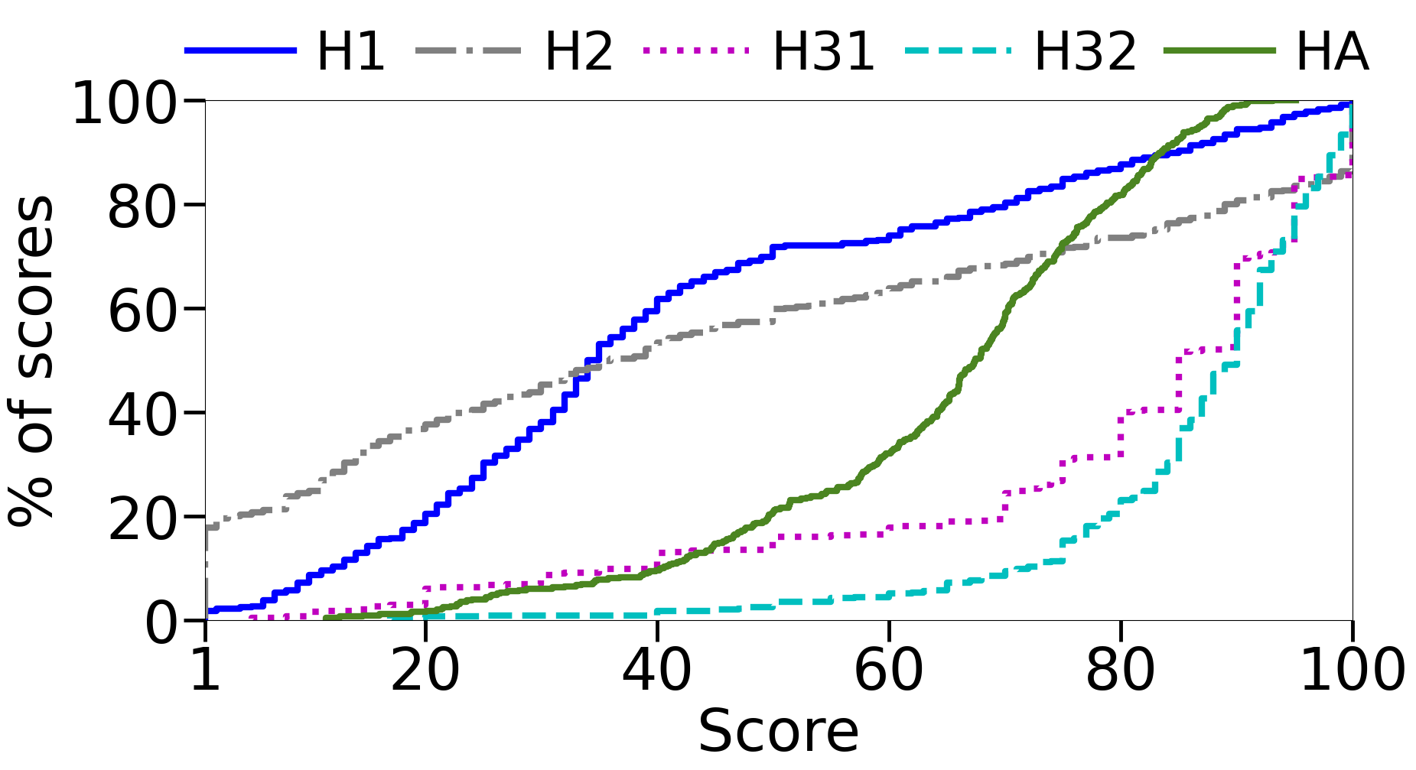
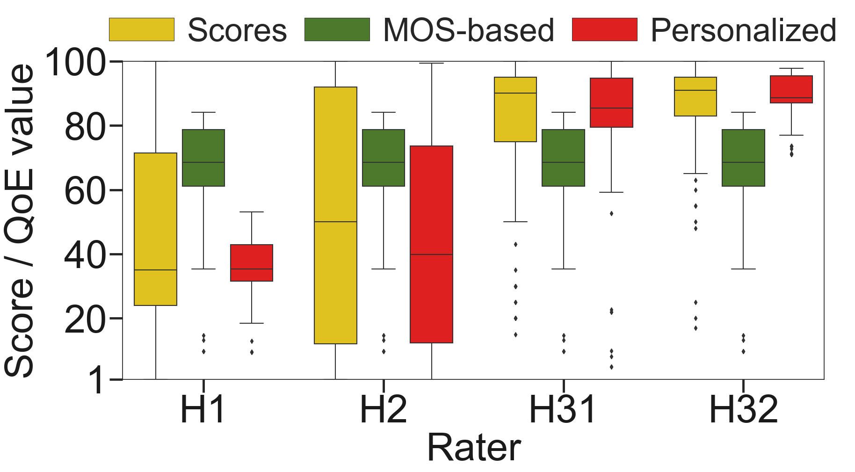
66
Inaccuracy of Traditional QoE Modeling
Waterloo-IV dataset

Slide 67
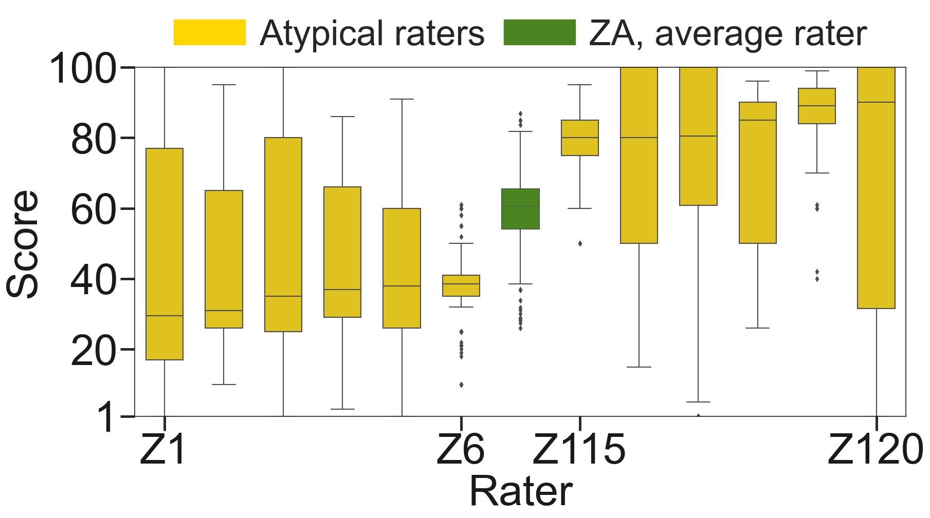
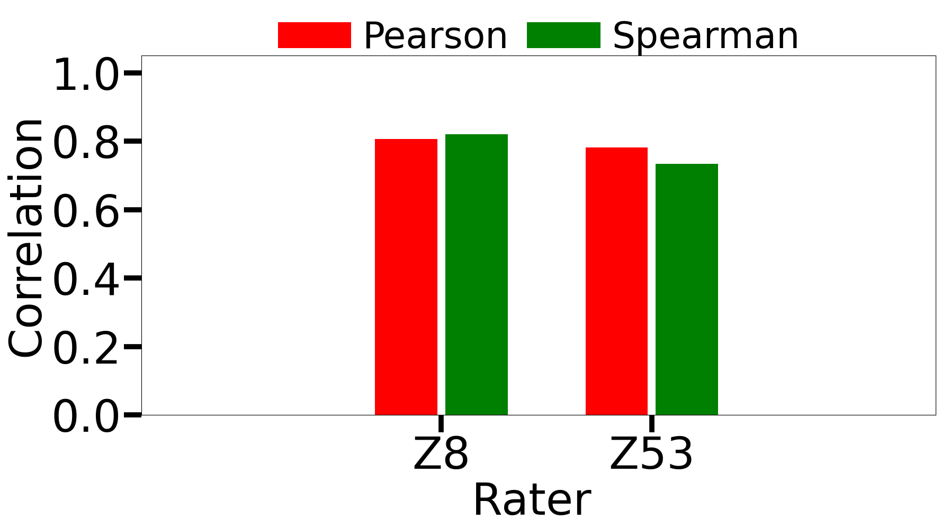
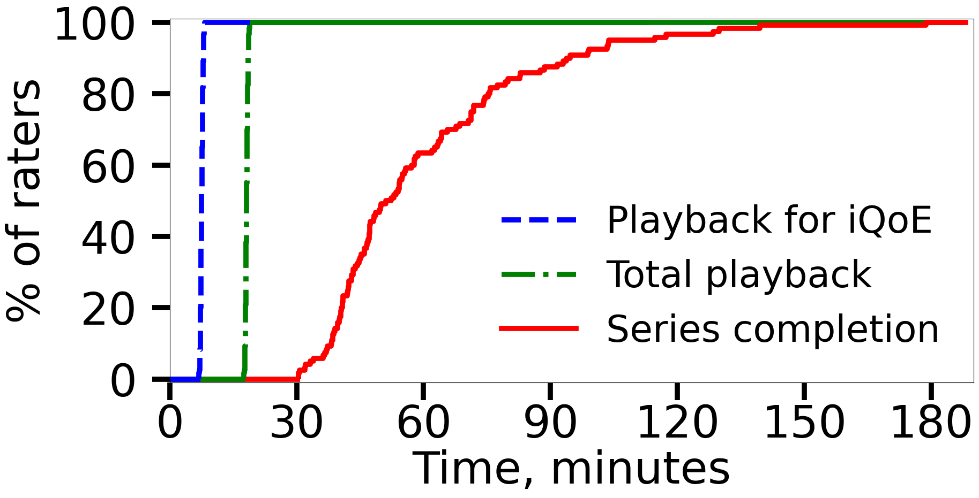
67
Results of the Subjective Studies

Slide 68
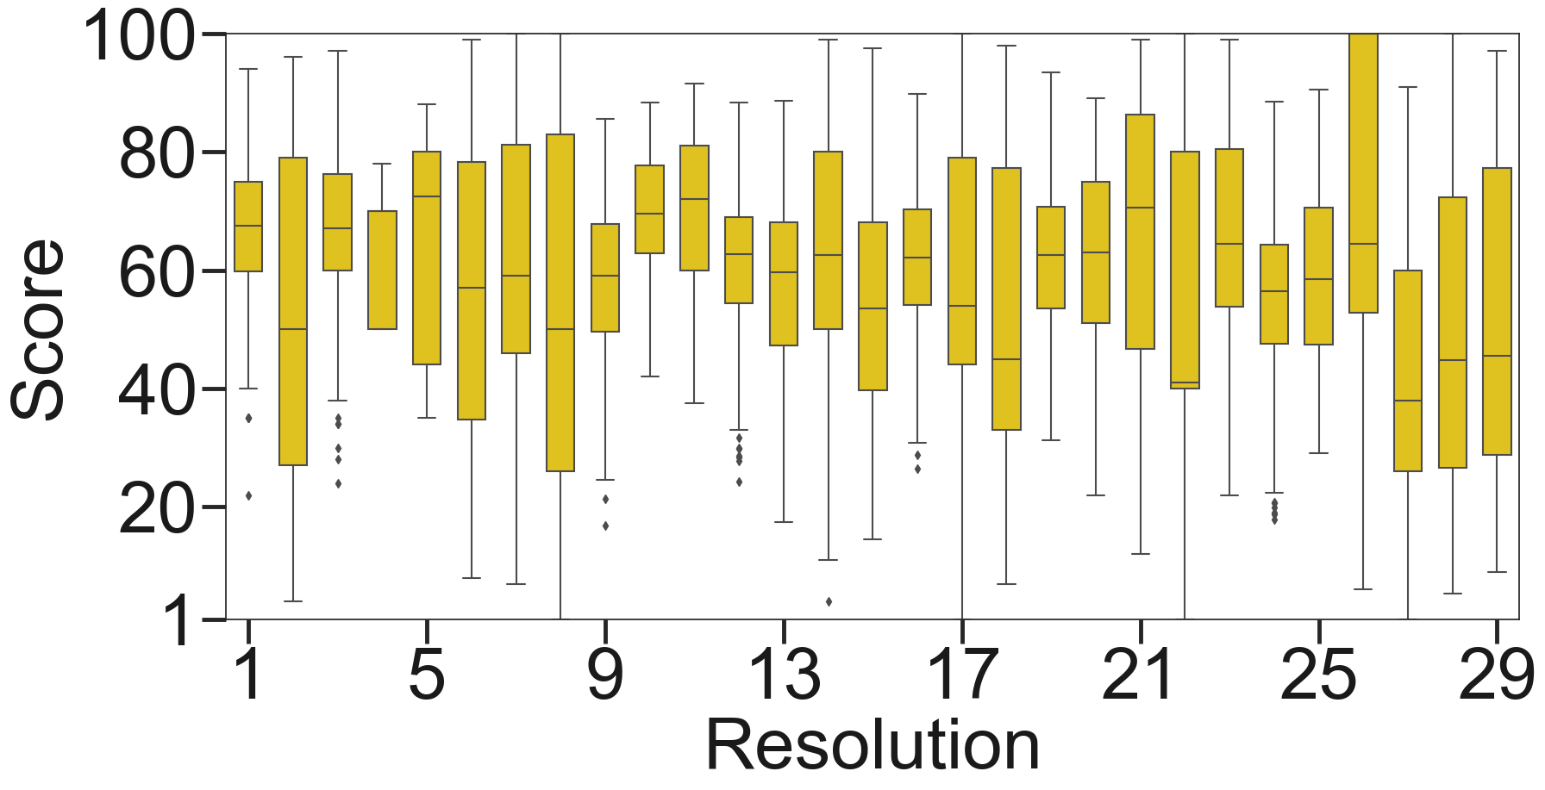
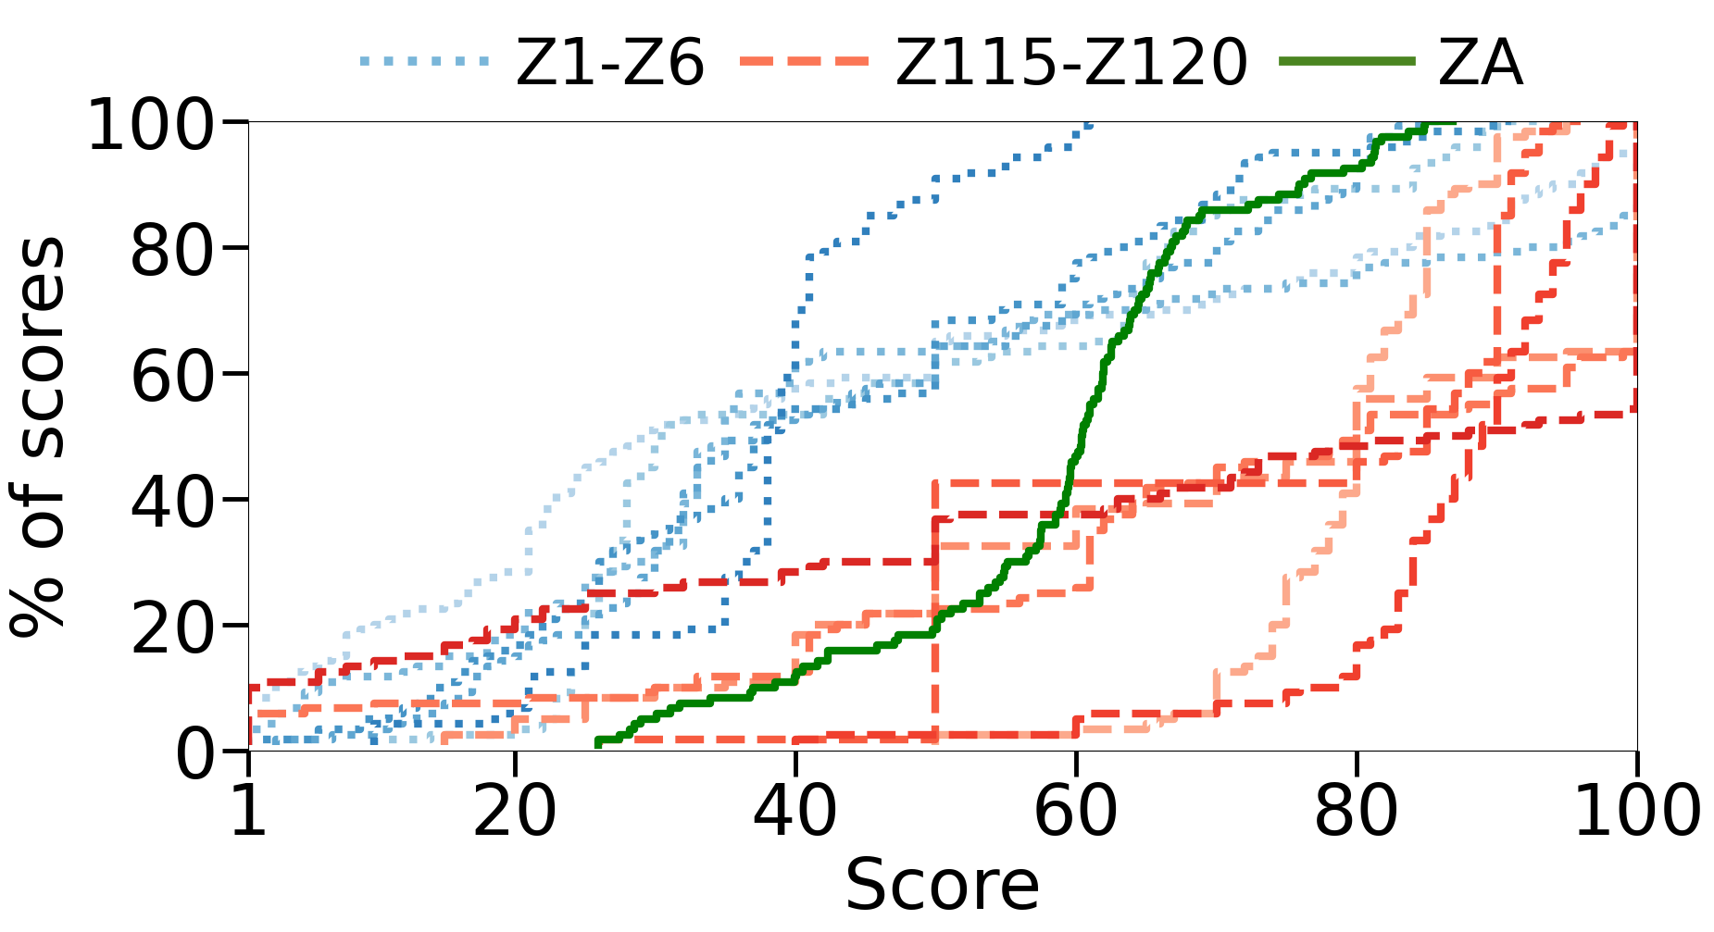
68
iQoE Dataset

Slide 69
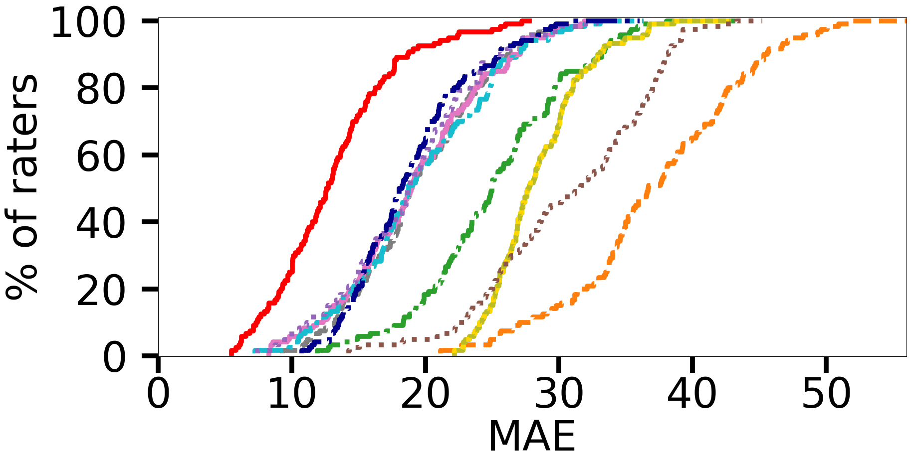
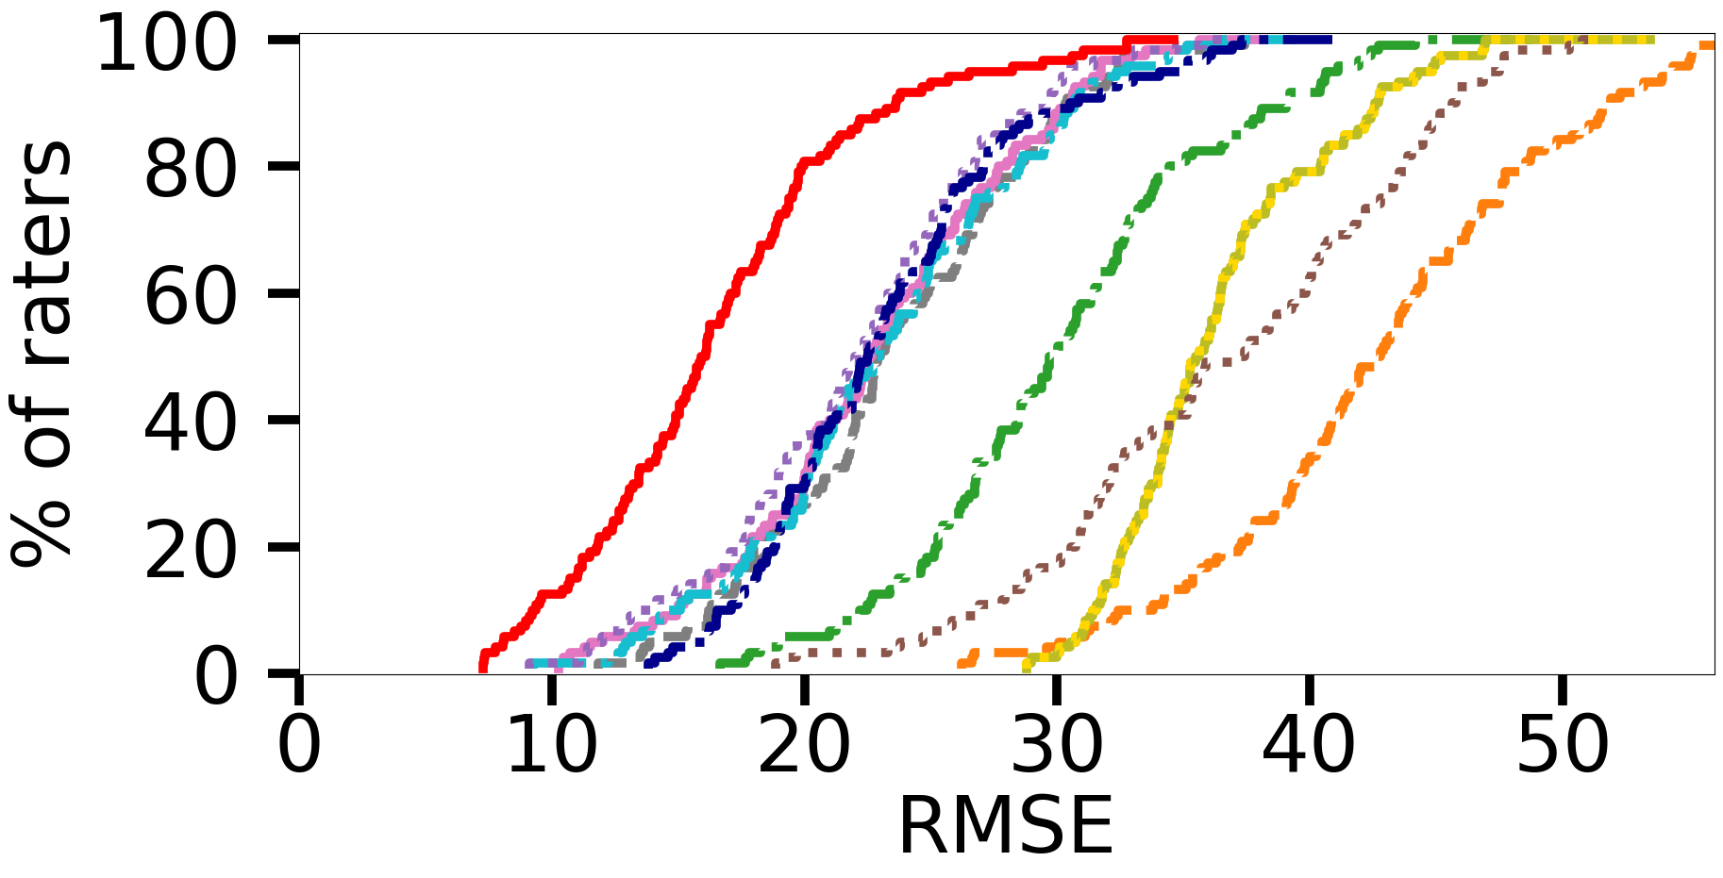
69
iQoE vs. Traditional QoE Modeling

Slide 70
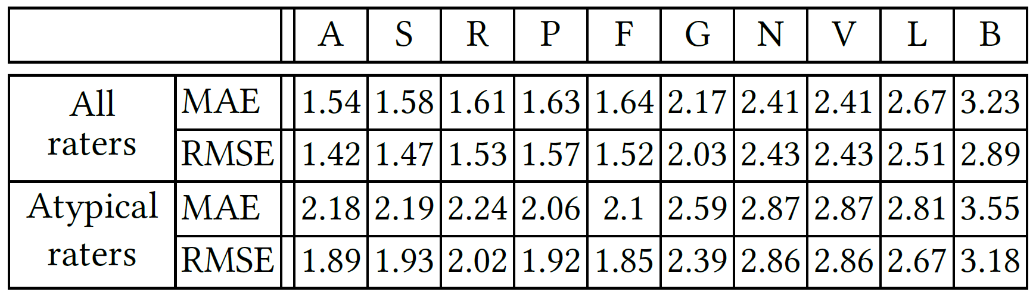
70
iQoE vs. Traditional QoE Modeling

Slide 71
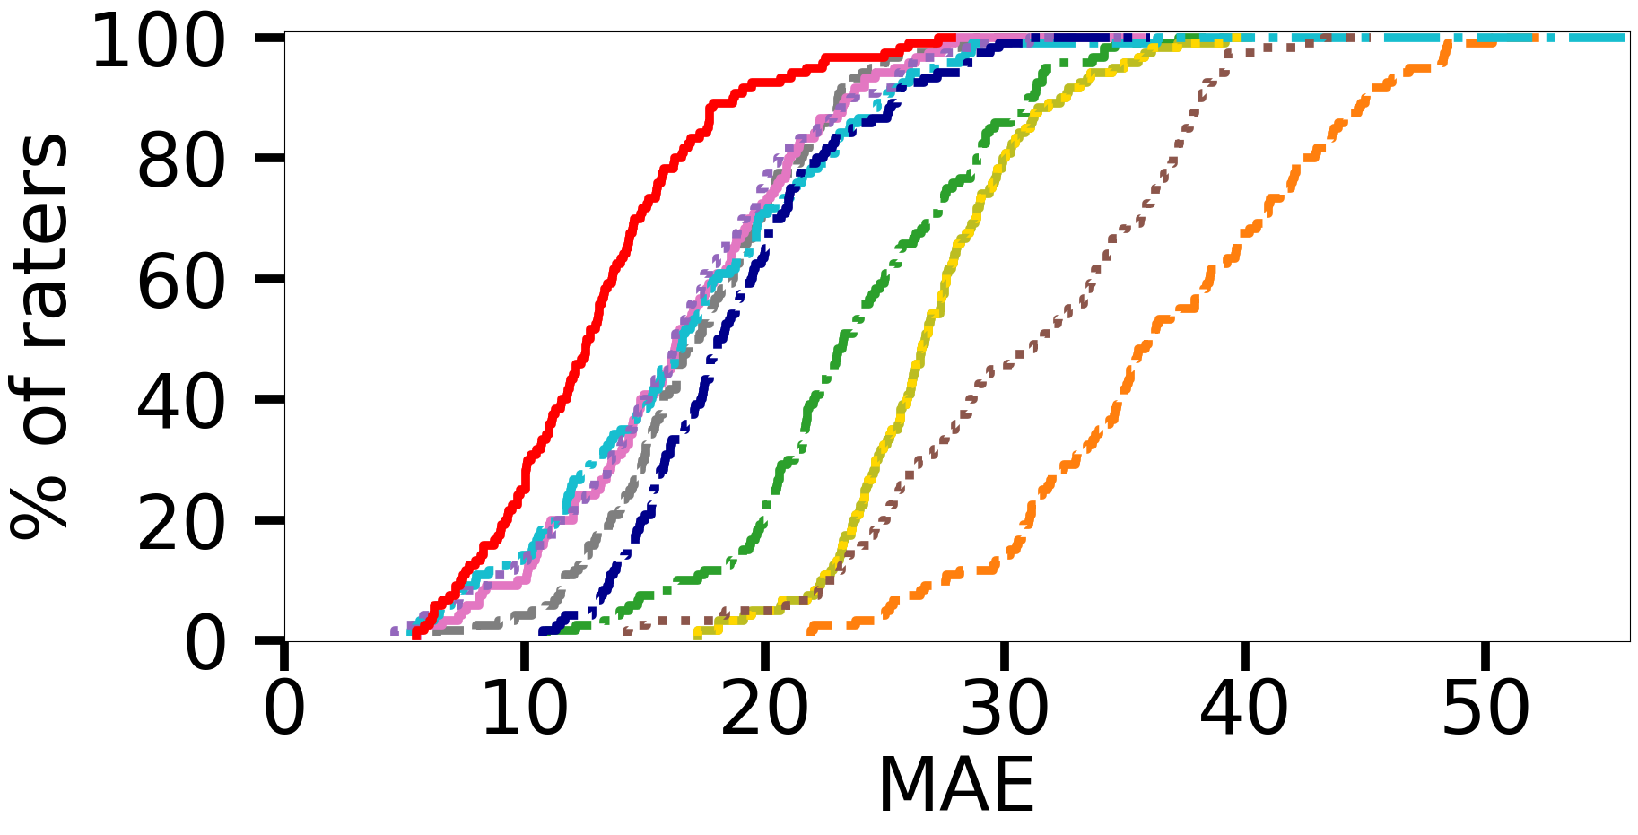
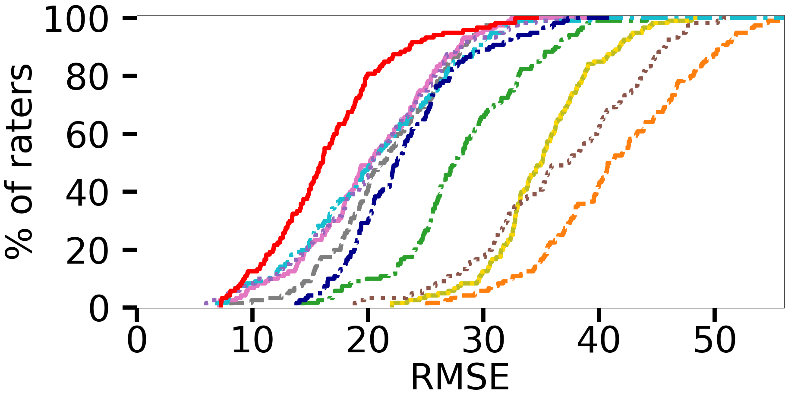
71
iQoE vs. Personalized QoE Modeling

Slide 72
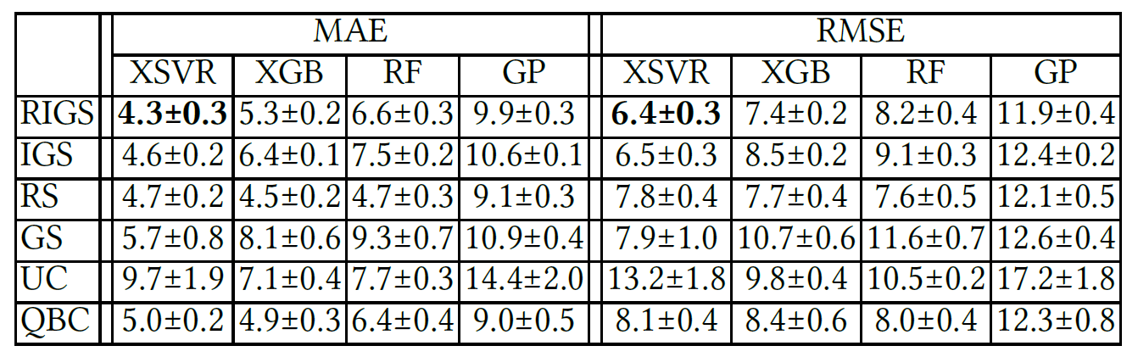
72
Sensitivity to the Modeler and Sampler Choices

Slide 73
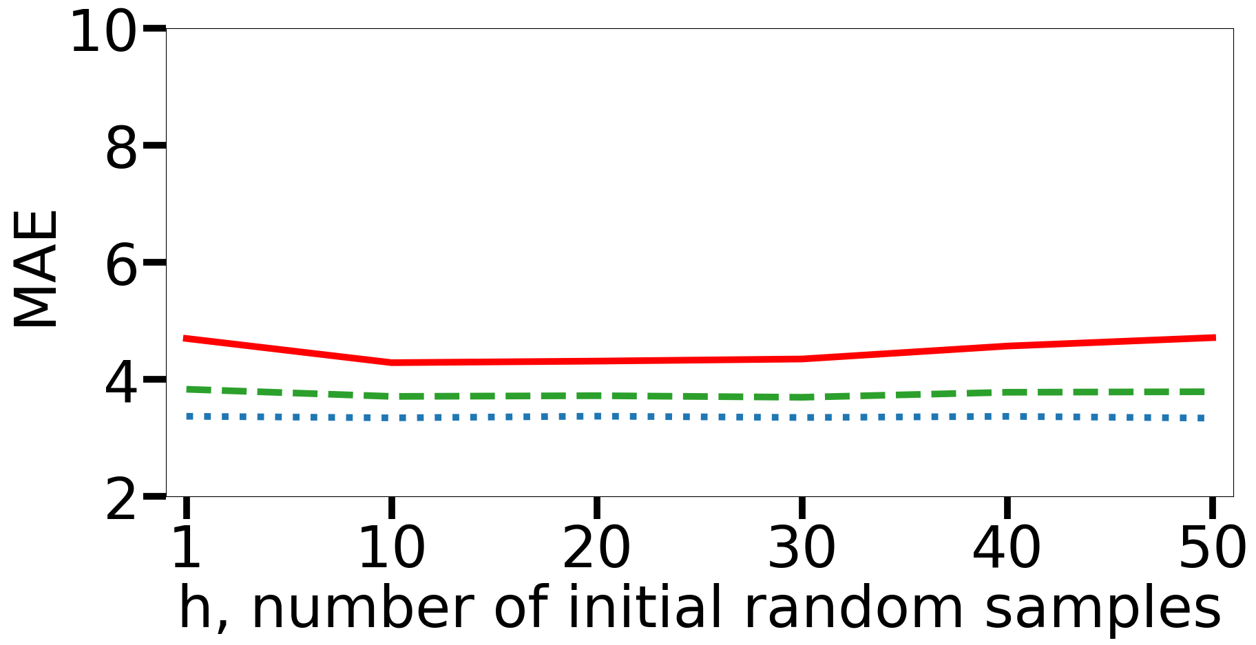
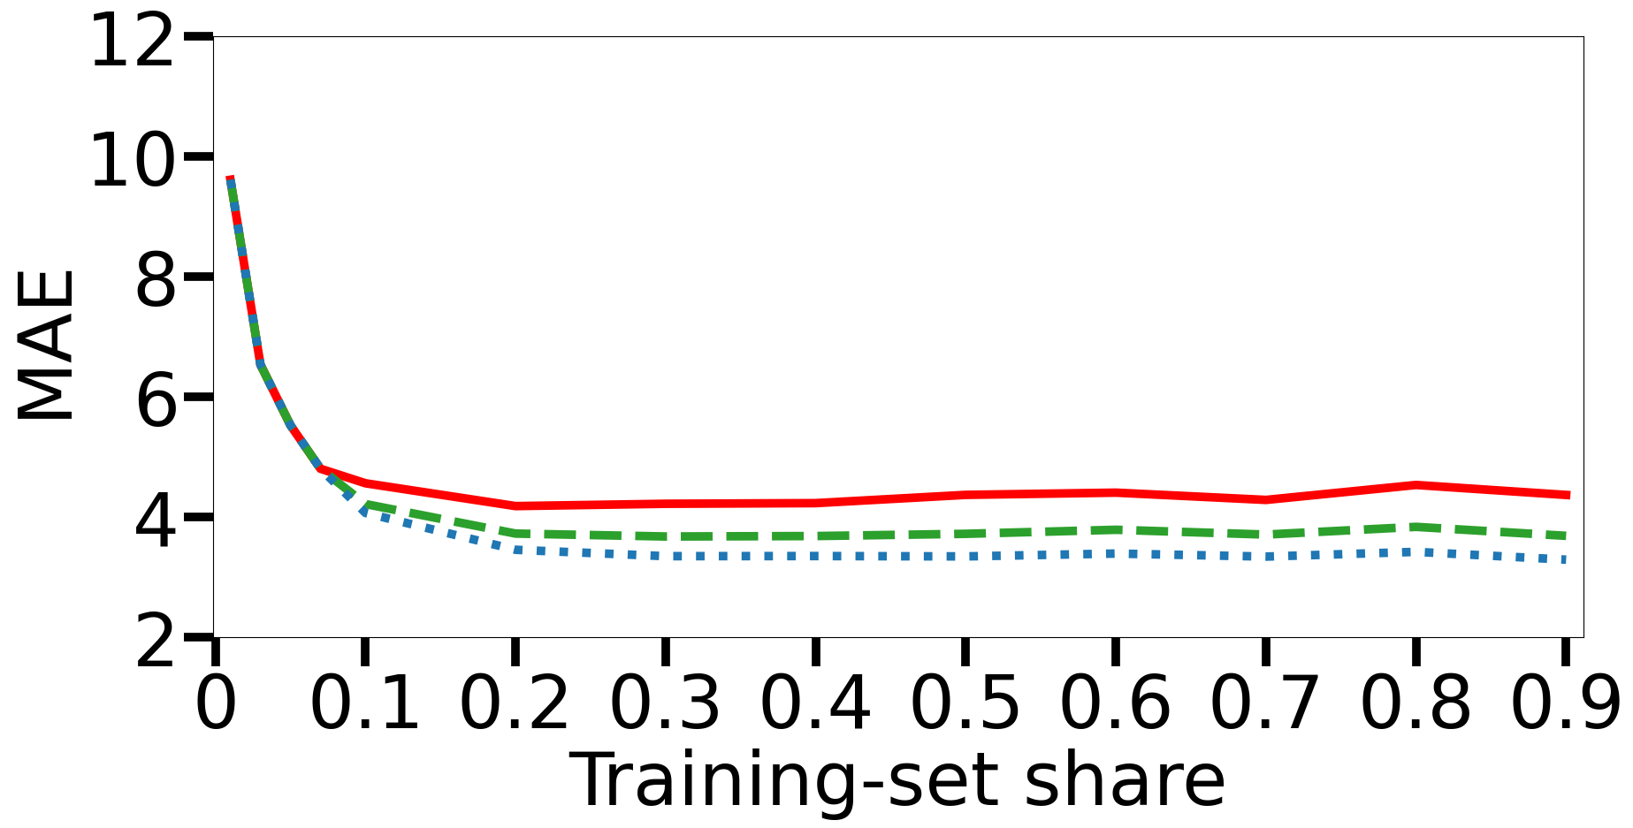
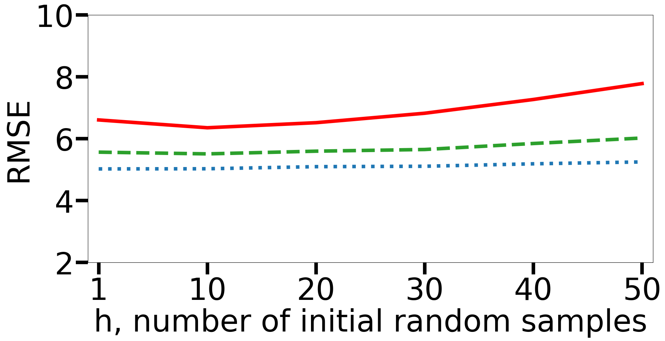
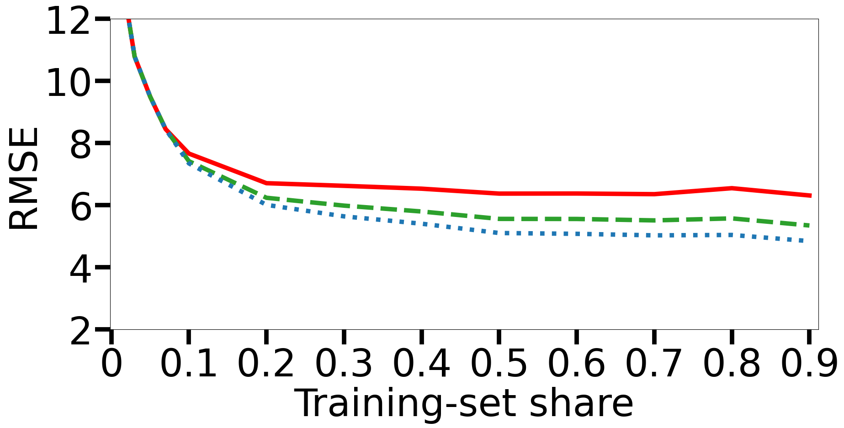
73
Sensitivity to Parameter h and Training-Set Share

Slide 74
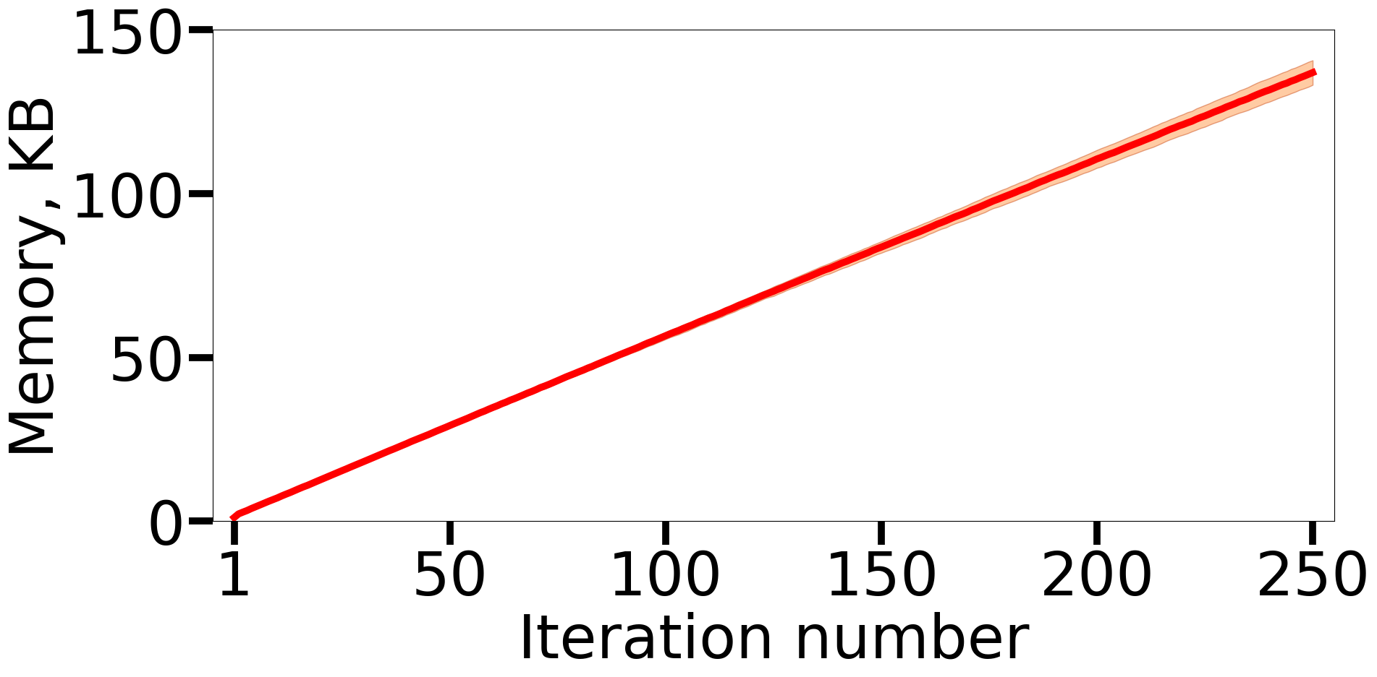
74
iQoE Processing and Memory Overhead

