Slide 1
RL-Cache: Learning-Based Cache Admission for Content Delivery
Sergey Gorinsky
IMDEA Networks Institute, Madrid, Spain
Joint work with Vadim Kirilin, Aditya Sundarrajan, and Ramesh K. Sitaraman
TEWI-Kolloquium, University of Klagenfurt, Austria
12 November 2021

Slide 2





Content Delivery Network (CDN)
CDN
Edge server
End user
Content provider
Access network
Origin server
Object delivery from edge servers
  low latency
  reduced traffic

Slide 3

Genius of CDN Economics
CDN
Edge server
End user
Content provider
Access network
Origin server
Object delivery from edge servers
  low latency
  reduced traffic
All stakeholders have incentives to deploy

Slide 4
The Good: Cache Hit
Edge server
Request
Hit
End user
Origin server

Slide 5
The Bad: Cache Miss
Edge server
Request
Miss
End user
Cold misses
Limited cache capacity
  one-time wonders
  object churn
Origin server

Slide 6
Caching Problem
Edge server
Miss
Which of the fetched objects are to be cached at any given time?
  constraint: fixed cache size
  objective: maximize the hit rate
Origin server

Slide 7
Caching Problem: Timing Constraints
Edge server
Miss
Real-time but neither tight nor hard
  latency of fetching the object
  asynchronous with serving the object to the end user
Origin server

Slide 8










Caching Challenges: Object Diversity
Different traffic classes
  web, image, video
Different object sizes within a class
?
An intractable knapsack problem

Slide 9



Caching Challenges: Online Operation
Now
Time
No optimal solution even for equal-size objects
  unlike László Bélády’s algorithm in the offline version

Slide 10



Caching Challenges: Online Operation
Unknown future
Now
Time
No optimal solution even for equal-size objects
  unlike László Bélády’s algorithm for the offline problem
Heuristics based on historical features
  request recency, frequency, object size

Slide 11



Prior Solutions
Edge cache
Admission
Eviction
AdmitAll
SecondHit
      AdaptSize
Much larger body of policies
Least Recently Used (LRU)
  predominant in production
Our goal: A simple admission front end for an LRU server

Slide 12
Caching by Reinforcement Learning (RL)
Natural fit between cache admission and RL
  state: request features
  action: admit or not admit
  reward: hit or miss
Limited prior RL-based work
  prefetching based on popularity as a proxy metric [DeepCache]
  equal-size objects and synthetic workloads

Slide 13
Alternatives within the RL Paradigm
Q-Learning and other Temporal Difference (TD) methods
  weak correlation between an action (admission decision upon a miss) and immediate reward (hit on the next request)
  imprecise estimation of action values under noisy reward signals
Monte Carlo (MC) algorithms
  action-value update based on the average return from all sampled long sequences of state-action pairs
  large overhead and vulnerability to high variance in the returns
Direct Policy Search (DPS) techniques
  individual returns of long state-action sequences
  direct learning of a policy on a high-return subset of sequences
  best performance in our preliminary evaluation

Slide 14
RL-Cache: Overview
an
DPS-based algorithm for cache admission
  8 features of 3 common types
  request recency, frequency, object size
  Feedforward neural network
  outputs the probability of admitting the requested object
Training
  periodic in the cloud
Inference
  real-time in the edge server

Slide 15
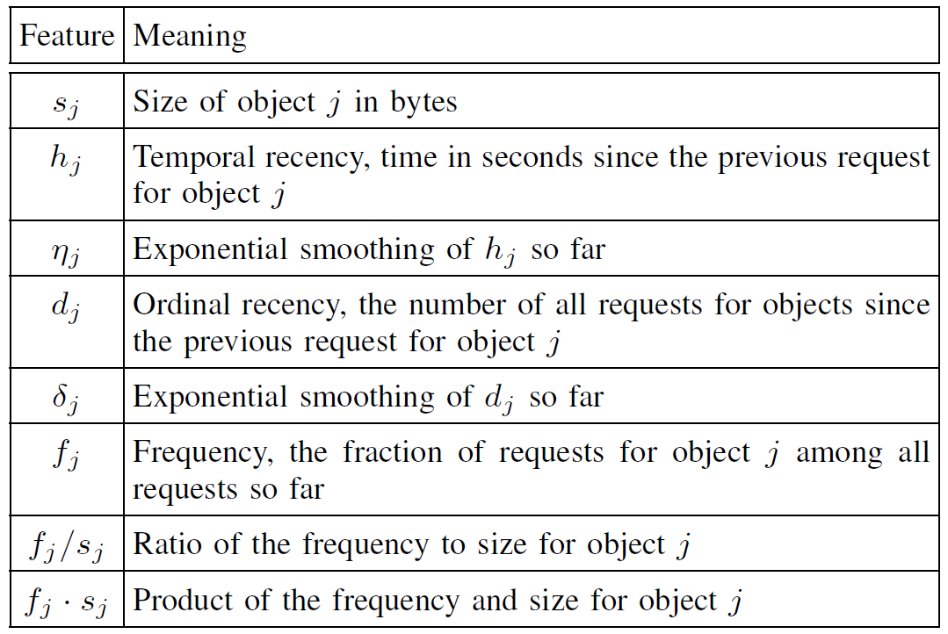
RL-Cache: Features

Slide 16
RL-Cache: Neural Network
admit
input layer
5 hidden layers
output layer
admitting
probability
…
………
……..
…….
…...
…..
non-admitting
probability
n inputs, up to 160
- 8 features;
- their historical
versions;
- up to 10 quantization
bins
ELU activation functions
softmax activation function
5(6-l)n neurons in hidden layer l
L2 regularization
Fully connected

Slide 17
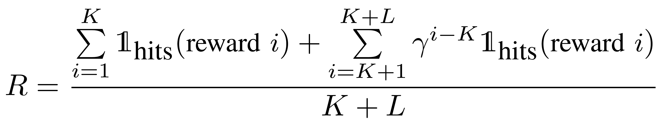
RL-Cache: Training
Trace
Window of K requests
. . .
Sampling
m samples
of admission decisions for
the window
. . .
Admission decisions
with discounted rewards
for L extra requests

Slide 18
RL-Cache: Training
Trace
Window of K requests
. . .
Sampling
m samples
of admission decisions for
the window
p samples with
highest hit rates
Selection
. . .
Admission decisions
with discounted rewards
for L extra requests

Slide 19
RL-Cache: Training
Trace
Window of K requests
. . .
Sampling
m samples
of admission decisions for
the window
p samples with
highest hit rates
Selection
. . .
Learning
Admission decisions
with discounted rewards
for L extra requests
not converged
Weights w

Slide 20
RL-Cache: Training
Trace
Window of K requests
. . .
Sampling
m samples
of admission decisions for
the window
p samples with
highest hit rates
Selection
. . .
Learning
Admission decisions
with discounted rewards
for L extra requests
converged
not converged
Weights w
Sliding to the next window; refilling the cache every q windows

Slide 21
RL-Cache: Inference
Real-time in the edge server
Maintenance with a database with feature statistics
  for computing the frequency and recency metrics
Rounding the inferred probability to 1 or 0
  to decide whether to admit or not to admit the requested
Request batching
  For reducing the per-request computation overhead

Slide 22
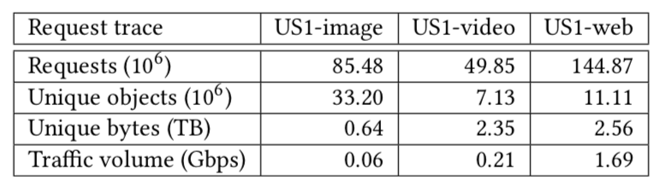
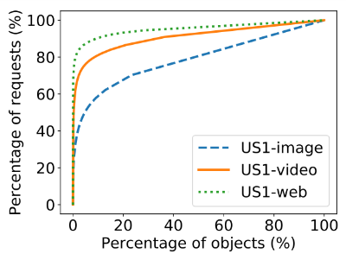
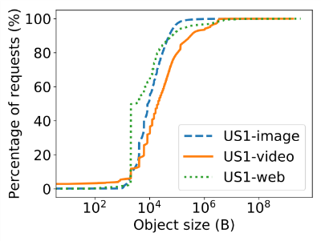
Evaluation: Initial Datasets
an
Image, video, and web traces from Akamai’s production server

Slide 23
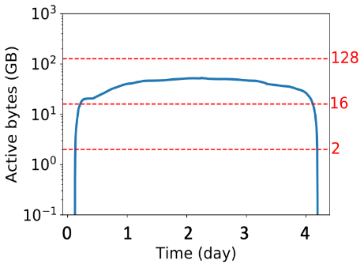
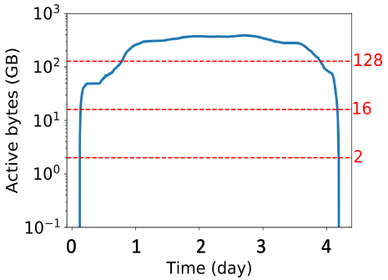
Active Bytes
an
Active object
  between its first and last requests in the trace
Active bytes
  total size of the active objects
Image
Web

Slide 24
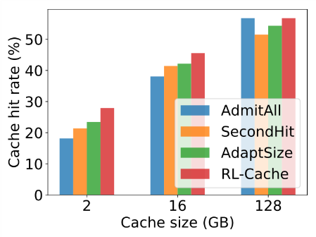
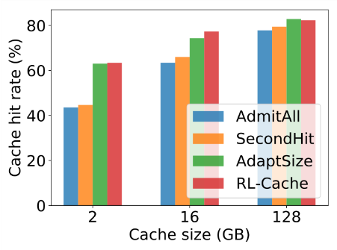
Hit-Rate Performance of RL-Cache
an
Successfully learns different strategies for different cache sizes
  e.g., admit all for abundant cache sizes
Outperforms or matches the existing algorithms
  across the cache sizes and traffic classes
  total size of the active objects
Image
Web

Slide 25
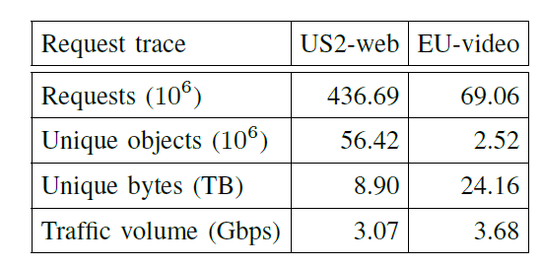
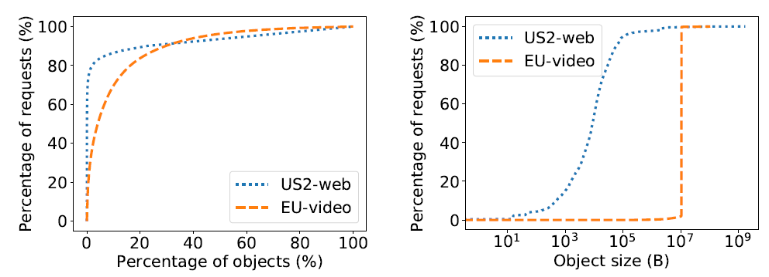
Evaluation: Additional Datasets
an
Additional geographic locations

Slide 26
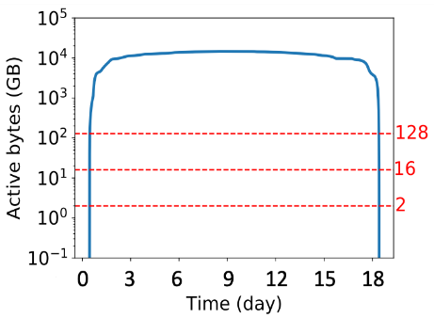
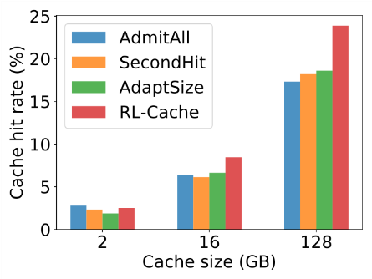
Impact by Larger Request Intensity
an
EU-video
RL-Cache outperforms the baselines

Slide 27
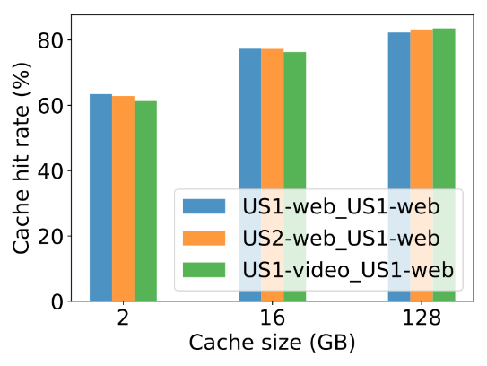
Robustness in the Same Geographic Region
an
RL-Cache can be trained in one and executed in other locations

Slide 28
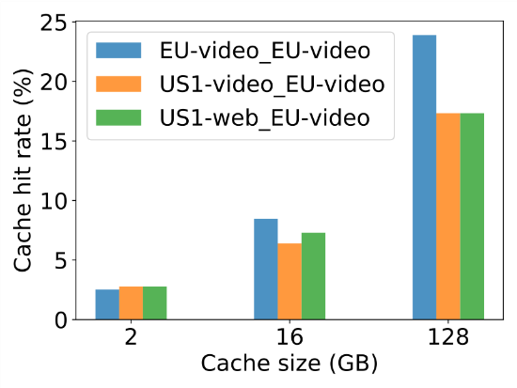
Robustness across Geographic Regions
an
Robustness across the continents is weak

Slide 29
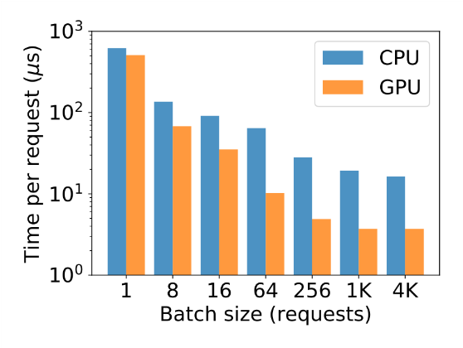
Processing Overhead
an
Per-request processing time is only 64 μs for CPU and 4 μs for GPU for the batch size of 1024 requests

Slide 30
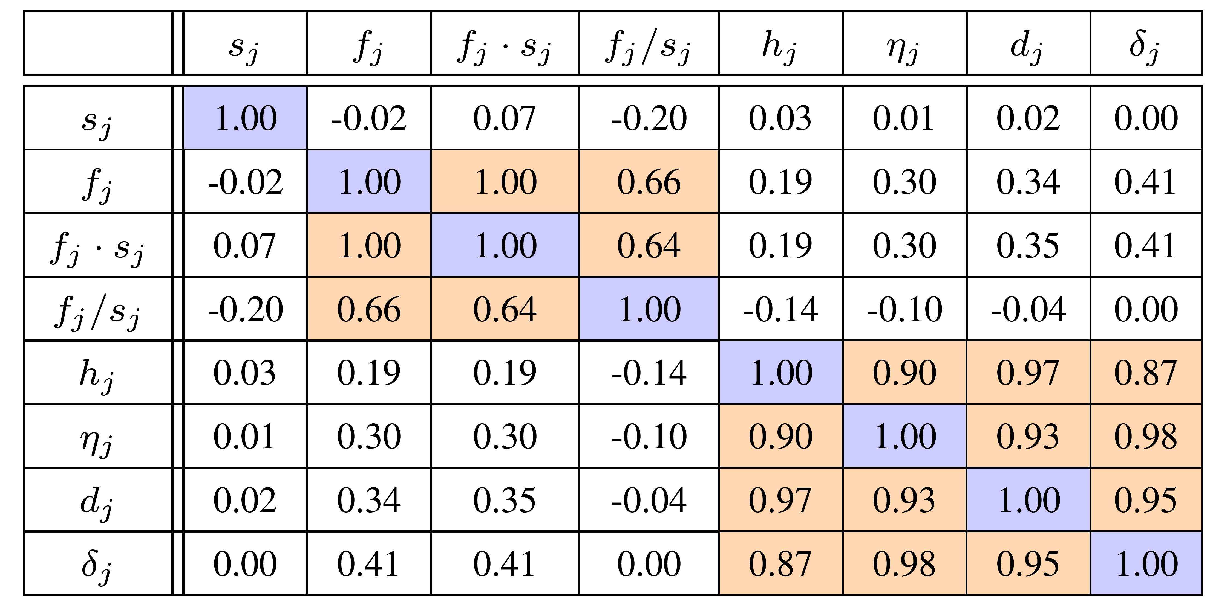
Pearson Correlation for Feature Pairs
EU-video
Grouping by feature class

Slide 31
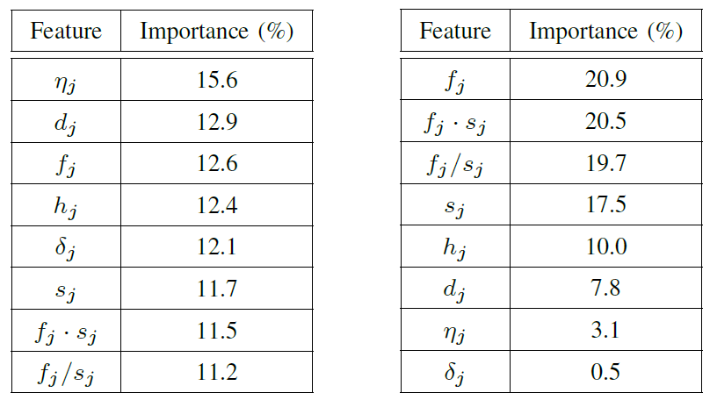
Feature Importance: Random Forests
EU-video
US1-image
Features of all 3 classes are important

Slide 32
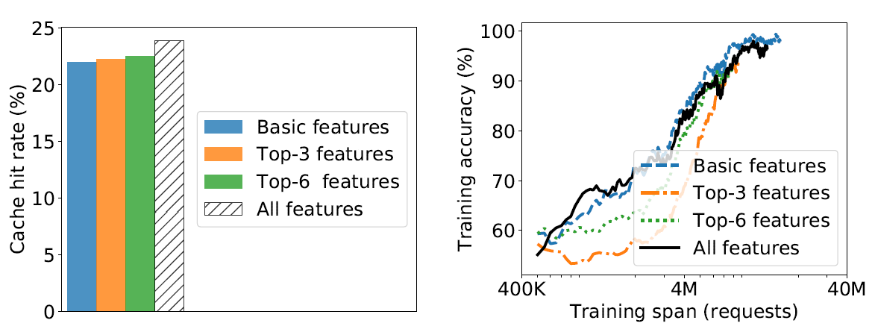
Reducing the Feature Set
EU-video
The full feature set provides the best performance

Slide 33
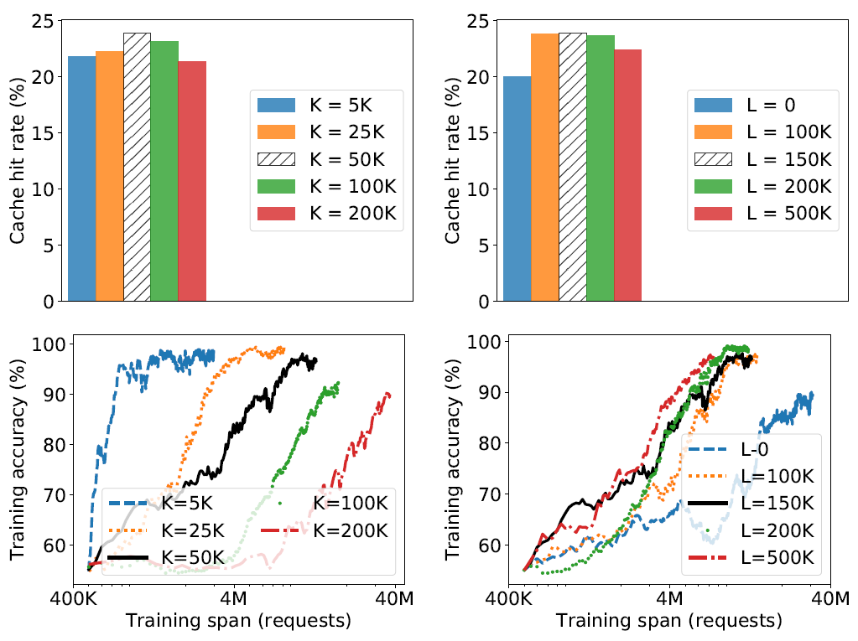
Hyperparameter Sensitivity: K and L

Slide 34
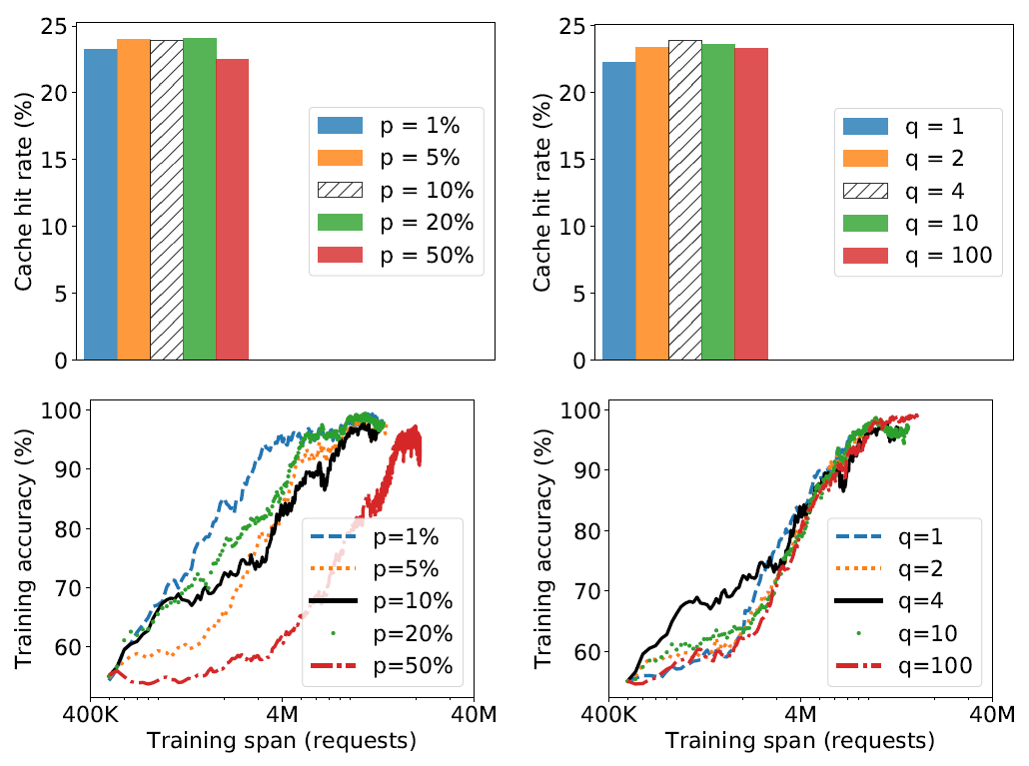
Hyperparameter Sensitivity: p and q

Slide 35
Conclusion
an
RL-Cache
    RL-based cache admission in a CDN edge server
    8 features of the recency, frequency, and size types
    training via direct policy search
    real-time inference with low batching-enabled overhead
Evaluation on Akamai’s production CDN traces
    active bytes as a measure of caching requirements for a trace
    successful adaptability in a variety of settings
    robustness across traffic classes in the same geographic region
    relevance of selected features and hyperparameters
Open software
    https://github.com/WVadim/RL-Cache

